Slide 1
E-mail
Electronic Mail

Slide 3
Gmail Accounts
www.gmail.com
USERNAME
Skyward Login
@alpinesd.org
Password
Same password as you use to log in to your computer

Slide 4
Info about E-mail
The first e-mails required both the sender and the receiver to be on-line at the same time
Definition of Email:
Messages that are sent and received through an internet server

Slide 5
Parts of e-mail
Header
To
Cc
Bcc
Subject Line
Body
Message
Signature
Attachment
Files that are sent with e-mails

Slide 6
Ways to Respond
Reply
Reply To All
Forward

Slide 8
Netiquette A set of social on-line rules
Spell Check
DO NOT USE ALL CAPS
(THIS IS YELLING)
Always fill in the subject line
Be careful with emoticons and abbreviations
Type what you mean
It is hard to read sarcasm in an e-mail. A good rule is to treat every post or e-mail as if you were sending a copy to your boss, your bishop and your worst enemy

Slide 9
Passwords
The most hacked passwords in 2014 were:
password
123456
Baseball
football
The best and most secure passwords include:
At least 8 characters long
Upper Case & Lower Case
Number
Special Character
(!@#$%^&*<>?)
Qwerty
Abc123
123456789
dragon

Slide 10
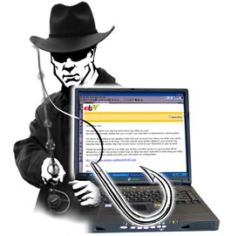
Be Careful Out There
Spam
Unsolicited unwanted bulk emails
(Like Junk mail on the internet)
Phishing
Attempting to acquire information such as usernames, passwords and credit card details (and sometimes, indirectly, money) by masquerading as a trustworthy entity in an electronic communication
Cyberbullying
Use of technology aimed to hurt someone

Slide 11
Avoid Being Hooked
Watch out for weird e-mails or domain endings
Weird hyperlinks
Misspelled words
Not addressing you with your name but using Customer or even “To Whom it may concern”
Making you feel like you’ve been invited or won a special prize
A threat given when you don’t do something within a given amount of time

Slide 12
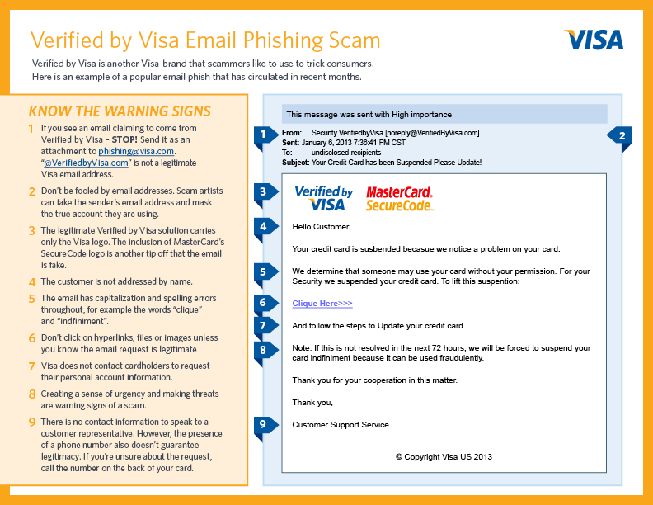

Slide 13
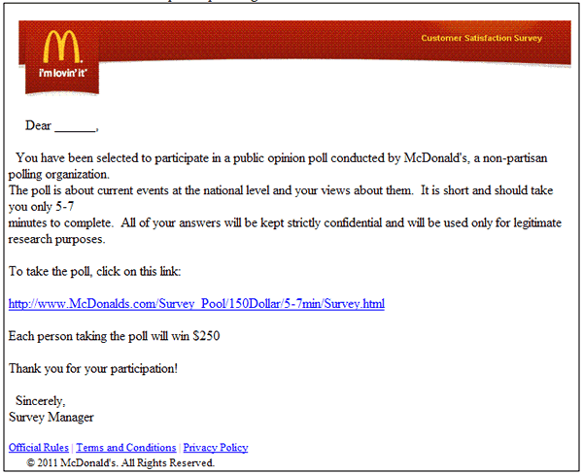

Slide 14
