Slide 1
Hardware
The physical parts of the computer

Slide 2
Definitions
CPU:
Central Processing Unit
Brains of the computer
All of the processing goes on through the CPU

Slide 3
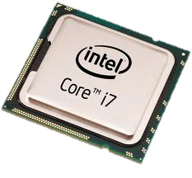
Hertz
Hertz measures the speed of a CPU
Hertz = number of cycles per second
Megahertz
Gigahertz
Terahertz

Slide 4
Definitions
RAM
Random Access Memory
Like the short term memory on the computer
Only VOLITILE INFORMATION CAN BE STORED HERE

Slide 5
Definitions
ROM
Read Only Memory
Like the Long Term Memory on the computer
ONLY NON-VIOLITILE INFORMATION CAN BE STORED HERE

Slide 6
RAM vs ROM
Requires a constant form of power to work
Programs that are turned on and running stored here for better efficiency
Volatile
(Elements erased when device is turned off)
Does not require a constant form of power
Start up files are found here
Non-Volatile
(Memory that will be saved when turned off)

Slide 7
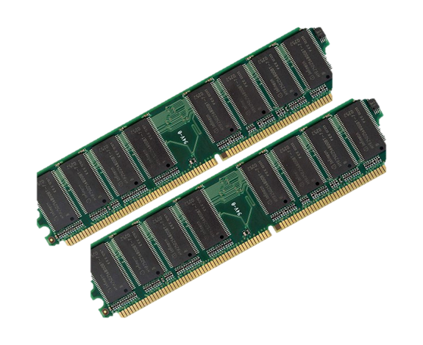
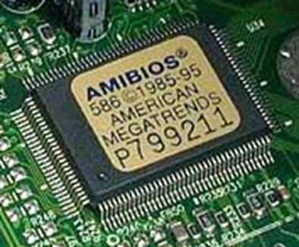
RAM vs. ROM
RAM
(Random Access Memory)
ROM (Read Only Memory)

Slide 8
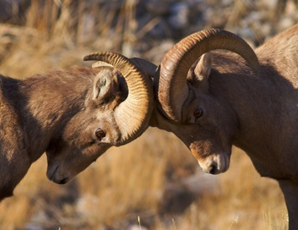
How to Remember RAM v. ROM
Think of all the brain cells that were lost when they hit their heads

Slide 9
How to remember RAM v. ROM
ROM
ON

Slide 10
Definitions Continued:
Motherboard
Heart of the computer
Main circuit board that connects everything together on the computer
Hard Disk Drive (Hard Drive)
Main storage unit on the computer

Slide 11
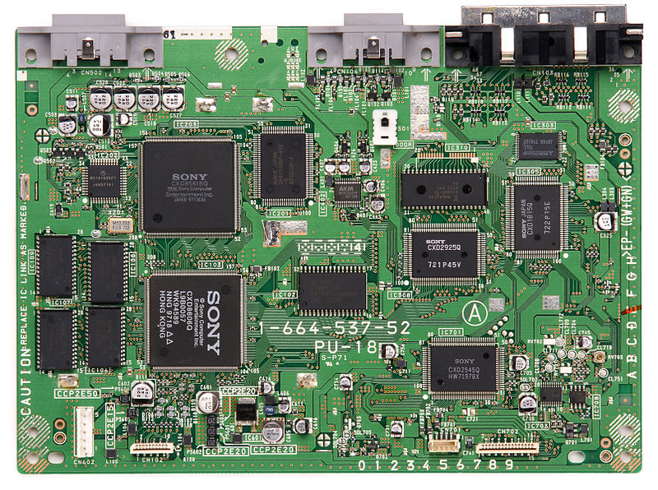
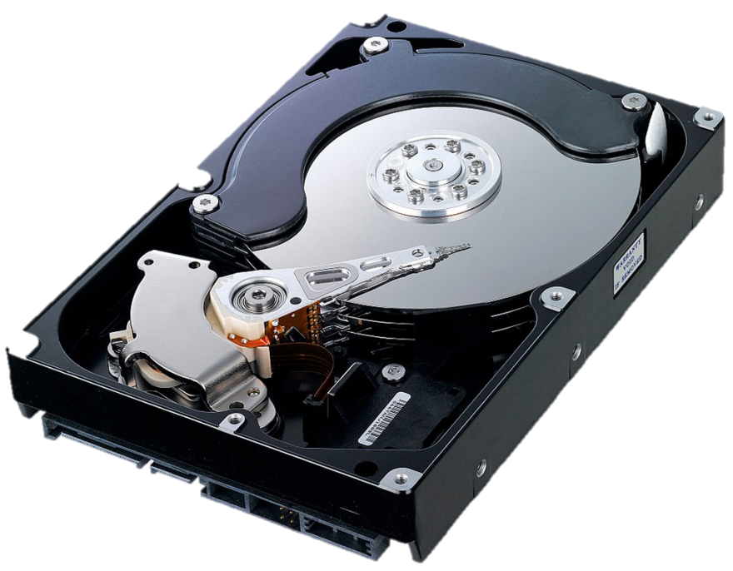
Motherboard & Hard Drive
Motherboard
The Green board that
holds it all together
Hard Drive
Main Storage area

Slide 12
Memory, what’s it all mean?
Bit …… Smallest Unit of Memory
Byte … 8 Bits = Bite
Kilobyte …… 1000 Bites (approx)
Megabyte … 1 Million Bites (approx)
Gigabyte …… 1 Billion Bites (approx)
250 Songs
Terabyte …… 1 Trillion Bites (approx)
Others: Petabyte, Exabyte, Zettabyte, Yottabyte

Slide 13
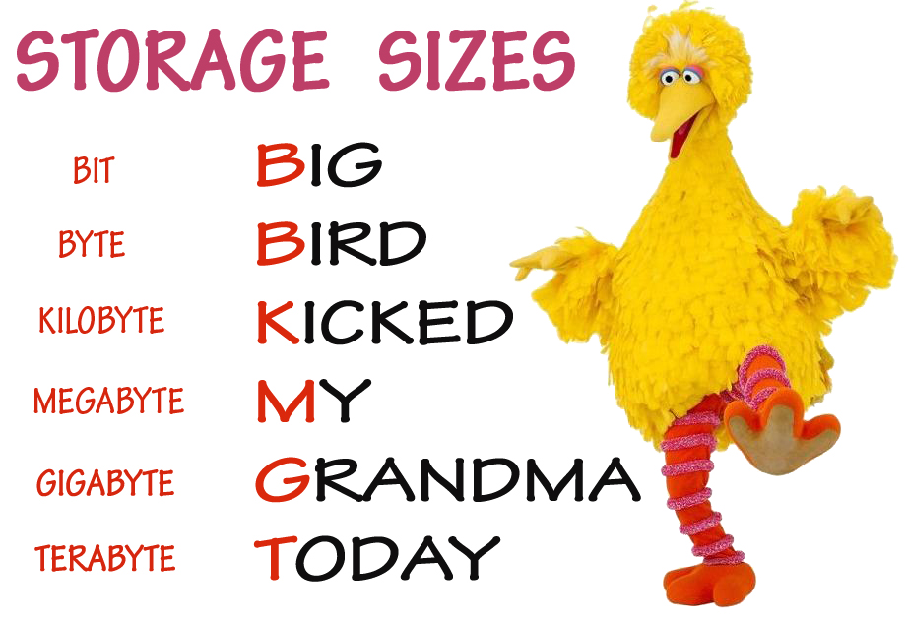
How are you going to remember it? Mnemonic Devices . . .

Slide 14
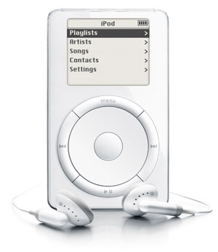
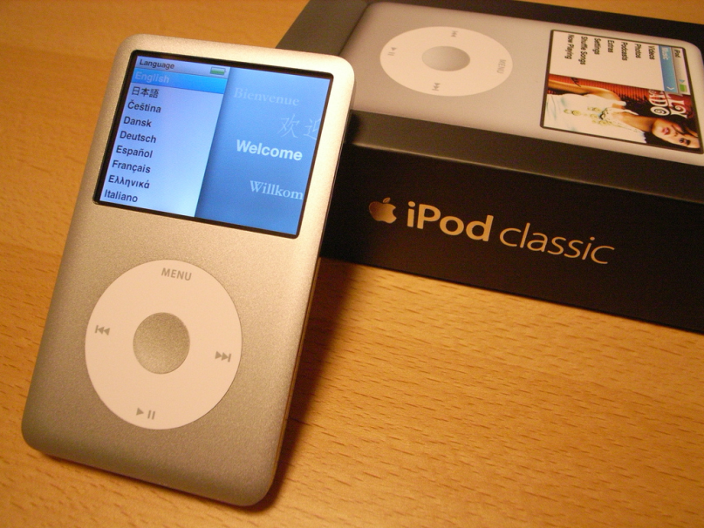
How Much Memory Do You Have?
1st Generation iPod
5GB = 1,000 Songs
iPod Classic (the newest one)
160 GB =
40,000 Songs
200 Hours of Video
25,000 Photos

Slide 15
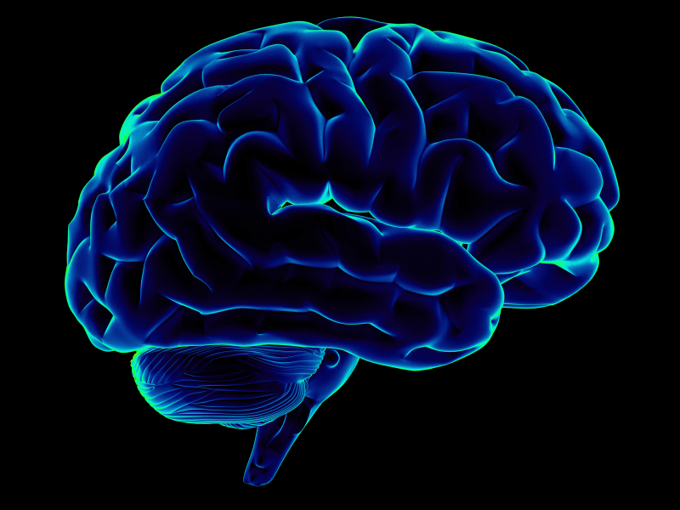
How much memory do you have?
Researchers estimate that your brain’s storage capacity is equal to:
2.5 Petabytes or 2,500 Terabytes
OR
3 Million hours of TV Shows
2.2 Trillion Photos
625,000,000 Songs

Slide 16
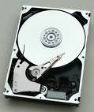
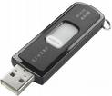
Storage Devices
Needed for permanently storing important information such as computer programs, files, and data.
Plastic or metal platters that are coated with oxide and store data magnetically.
Magnetic Storage
Hard Disk
Floppy Disk
Videotape
A storage medium on which data is recorded and read by two lasers
Optical Storage
CDs
DVDs
A small storage device that can be plugged into a USB port.
USB Storage

Slide 17
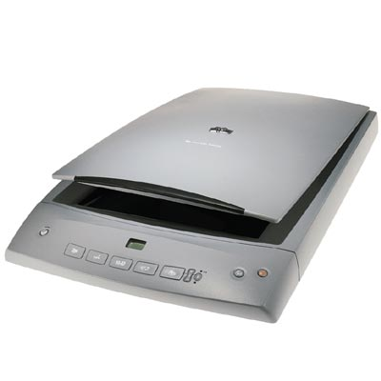
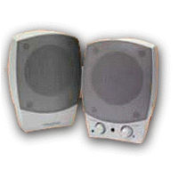
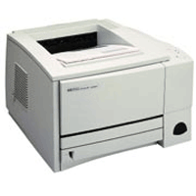
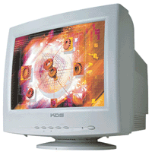
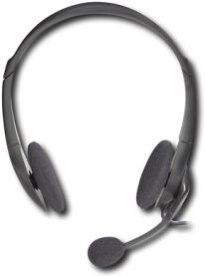
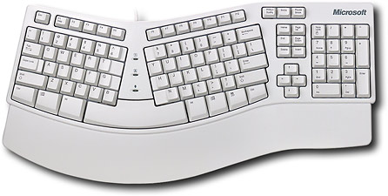
Input / Output
Speakers
Output
Printer
Output
Scanner
Input
Keyboard
Input
Headset with Microphone
Input/Output
Monitor
Output
Mouse
Input

Slide 18
Peripheral Device
Any device that broadens the use of your computer
Printers
Scanners
Digital Cameras
Tablets

Slide 19
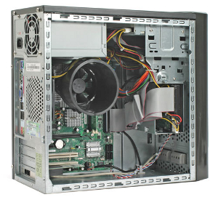
Lets look inside . . .

