Slide 1
Introduction to
Microsoft Word
Start the Presentation from the Current Slide.
The arrows will take you to the next page.
Follow instructions carefully.
Next

Slide 2

Microsoft Word
What is it?
Document Processing Program
  Microsoft Office, Google Docs and Pages (from Mac) are examples of Word Processing Programs
What can you make with a Word Processing Program?
  Memos
  Reports
  Business Cards
  Posters
  Business Documents
  Letters
  Notes

Slide 3
Default Settings
What does DEFAULT mean?
  The settings when you open a program.
Word’s default settings are:
  Font: Calibri
  Size: 11 pt.
  Color: Black
  Alignment: Left
  Spacing: 1.15
  Orientation: Portrait
Next

Slide 4
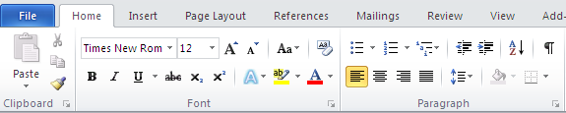
Home Ribbon - Clipboard Section
Paste: Ctrl + V
Copy: Ctrl + C
Cut: Ctrl + X
Next

Slide 5
Home Ribbon - Font Section
Font Style: The look of the text
Font Size : How big or small the font appears. Font sizes are based on a 1/72” scale.
1” printed out = 72 size font
Next

Slide 6
Home Ribbon - Font Section
BOLD: makes the font BOLD to stand out.
Keyboard shortcut: Ctrl + B
Italics: makes the font ITALIC to stand out.
Keyboard Shortcut: Ctrl + I
Underline: makes the font Underlined to stand out.
Keyboard Shortcut: Ctrl + U
Next

Slide 7
Home Ribbon – Font Section
Highlighter – highlights text
Font Color – change the color of the font by clicking the down arrow
Next

Slide 8
Home Ribbon – Paragraph Section
Bullet Points - organize info with bullet points.
Carrots
Oranges
Apples
Bananas
Numbering - organize info with numbers.
Michael Jordan
Kobe Bryant
Lebron James
Steph Curry
Karl Malone
Next

Slide 9
Home Ribbon – Paragraph Section
Alignment – aligns the font either on the left or right side, down the center, or aligned equal on both sides.
Next

Slide 10
Alignment Continued…
Left Aligned (Ctrl + L) – left side of text is all lined up. Right side is uneven.
Always become familiar with a chat room before you take part in a discussion. You need to do this to learn the basic rules and the kinds of topics discussed in the chat room. If the chat room topics cannot be openly discussed with your friends or parents, you should stay out of the chat room
Center Aligned (Ctrl + E) – text is lined up down the middle so both sides of text are uneven.
Always become familiar with a chat room before you take part in a discussion. You need to do this to learn the basic rules and the kinds of topics discussed in the chat room. If the chat room topics cannot be openly discussed with your friends or parents, you should stay out of the chat room
Next

Slide 11

Alignment Continued…
Right Aligned (Ctrl + R) – Right side of text is all lined up. Left side is uneven.
Always become familiar with a chat room before you take part in a discussion. You need to do this to learn the basic rules and the kinds of topics discussed in the chat room. If the chat room topics cannot be openly discussed with your friends or parents, you should stay out of the chat room
Justify Aligned (Ctrl + J) – Both left and right sides are even.
Always become familiar with a chat room before you take part in a discussion. You need to do this to learn the basic rules and the kinds of topics discussed in the chat room. If the chat room topics cannot be openly discussed with your friends or parents, you should stay out of the chat room
Next

Slide 12
Paragraph Section – Line Spacing
Line Spacing – amount of space between each line of text.
2. 0 = Double Space
(A line of text can be placed between each line of test)
-Example Below-
Sometimes the online world can feel "pretend" because you cannot see the person with whom you are communicating.
1.0 = Single Space
(no space in between each lines)
-Example Below-
Sometimes the online world can feel "pretend" because you cannot see the person with whom you are communicating.
Next

Slide 13

Other Info to Know
Margins: Blank white space around the edges of the document.
  To change Margins:
    Page Layout Tab
    Margins
    Custom Margins or choose an existing margin
Next

Slide 14
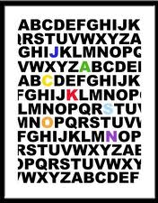
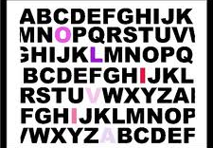
Other Info to Know
Page Orientation: the way the page prints out.
  Default Orientation: Portrait
  To Change:
    Page Layout Tab
    Orientation
    Choose Portrait or Landscape
Portrait (Tall Ways)
Landscape (Long Ways)
Next

Slide 15
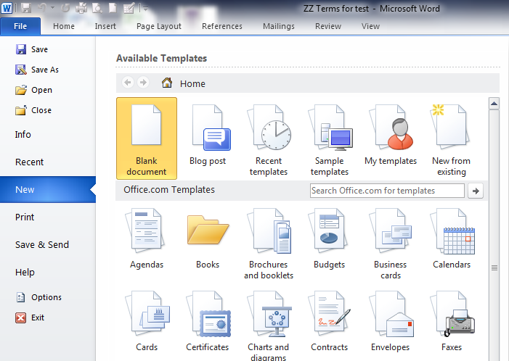
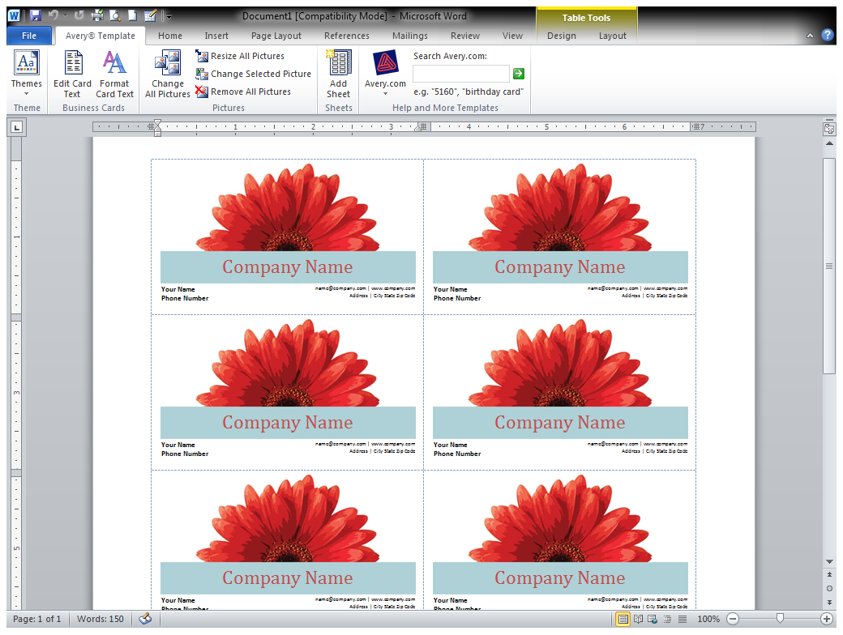
Templates
A file that serves as a starting point for a new document. It is pre-formatted so all you have to do is add your own info.
Next

Slide 16
Other Info to Know
Print – (Ctrl +P)
  File Tab
  Print
  Change the printer if needed
Save – (Ctrl + S)
  File Tab
  Save
If you make a mistake like deleting something on accident
Ctrl + Z
Is your best friend! ☺
Next

Slide 17
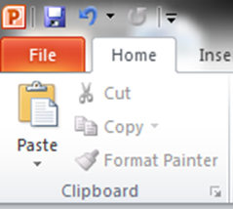
The Clipboard
The Clipboard is software that saves information when you have Copied, Pasted or Cut items from your computer programs
Next

Slide 18
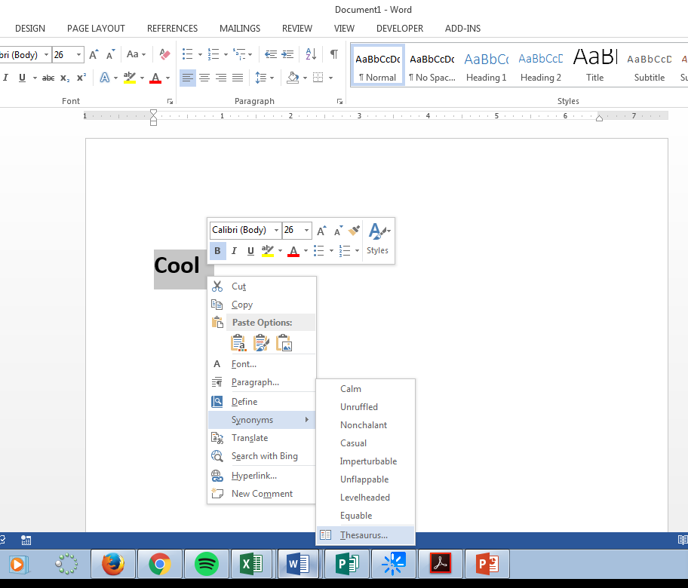
Thesaurus
Tool used to suggest new meanings for words you’ve used in your document
Steps:
Type in your word
Highlight the word you want to replace
Right Click
Hover over Synonyms
Click on Thesaurus
Next

Slide 19
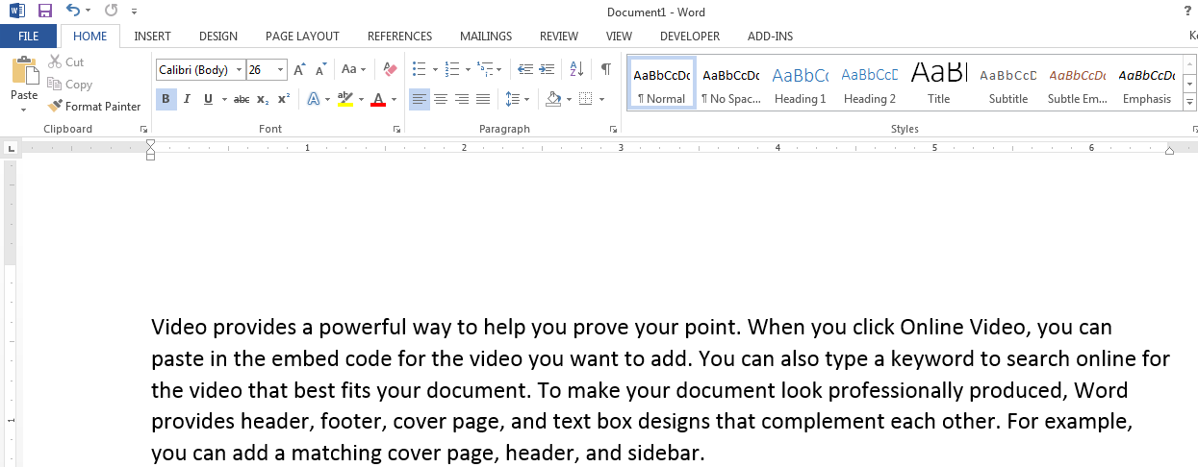
Ruler Bar
Measured or numbered scale that appears at the top of a document window. Shows you tab stops and margin settings.
Next

Slide 20
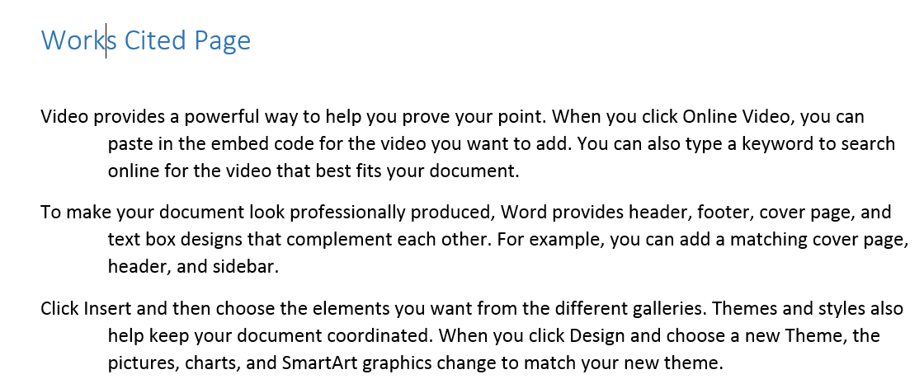
Hanging Indent
Type of indent used on a Works Cited or references sheet.
First Line is straight across
Every other line in the paragraph is indented in
First line straight
Other lines indented
First line straight
Other lines indented
Next

Slide 21
Proofing Errors & Editing
Wavy Green Line: Indicates a possible grammar error
Wavy Red Line: Indicates a possible spelling error
Proofreading: Reading through your work to catch errors that Spell Check and Grammar Check won’t find. For example: Using “two” instead of “too” or “we’re” or “were”
Next

Slide 22
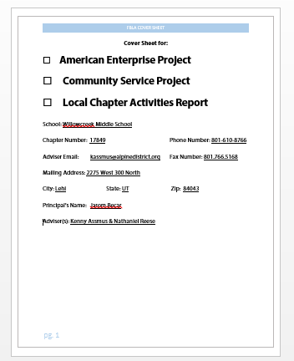
Parts of a Document
Header
Headers are at the top of a document. They repeat themselves on every page.
Body
The body is the main part of the document. It’s where you type all your stuff.
Footers are at the bottom. They usually include page numbers
Footer
Next

Slide 23
Tables
Tables are organization tools used to keep track of information
Last Name | First Name | Score
Smith | Mark | 36
Jones | William | 30
Cell:
Individual box in a table
Row:
Collection of cells that Run horizontally
Column:
Collection of cells that
Run vertically
Next

Slide 24
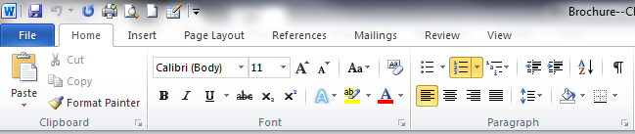
Quiz Time!!!!!!
1. If you wanted to bold a sentence or word, which button on the ribbon would you choose?

Slide 25

That is not correct. Please try again.
Go Back

Slide 26

Excellent Job!
NEXT QUESTION

Slide 27
2. This sentence is written in what type of font style? (Look closely, it’s a little slanted.)

Slide 28

That is not correct. Please try again.
Go Back

Slide 29

Excellent Job!
NEXT QUESTION

Slide 30
3. The paragraph below as been formatted using which style of alignment? Choose the button on the ribbon.
The quick brown fox jumps over the lazy dog. The quick brown fox jumps over the lazy dog. The quick brown fox jumps over the lazy dog. The quick brown fox jumps over the lazy dog. The quick brown fox jumps over the lazy dog.

Slide 31

That is not correct. Please try again.
Go Back

Slide 32

Excellent Job!
NEXT QUESTION

Slide 33
4. The paragraph below has been formatted using which style of alignment?
The quick brown fox jumps over the lazy dog. The quick brown fox jumps over the lazy dog. The quick brown fox jumps over the lazy dog. The quick brown fox jumps over the lazy dog. The quick brown fox jumps over the lazy dog.

Slide 34
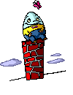
That is not correct. Please try again.
Go back to question

Slide 35

Excellent Job!
NEXT QUESTION

Slide 36
5. The paragraph below was formatted using which alignment?
The quick brown fox jumps over the lazy dog. The quick brown fox jumps over the lazy dog. The quick brown fox jumps over the lazy dog. The quick brown fox jumps over the lazy dog. The quick brown fox jumps over the lazy dog. The dog is really lazy.

Slide 37
That is not correct. Please try again.
Go back to question

Slide 38
Excellent Job!
NEXT QUESTION

Slide 39
6. The following list is using which type of organizational function?
Milk
Eggs
Bread
Cheese
Butter
Doritos

Slide 40

That is not correct. Please try again.
Go back to question

Slide 41

Excellent Job!
NEXT QUESTION

Slide 42
7. Which button would you produce to make the following?
Michael Jordan
Kobe Bryant
LeBron James
Tim Duncan
Bill Russell

Slide 43

That is not correct. Please try again.
Go back to question

Slide 44

Excellent Job!
NEXT QUESTION

Slide 45
8. Which one is landscape layout?

Slide 46
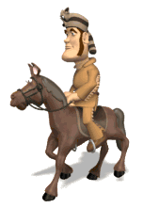
That’s not correct. Please try again
Go back to question

Slide 47

Excellent Job.
NEXT QUESTION

Slide 48
9. Which one is in portrait layout?

Slide 49
That’s not correct. Please try again
Go back to question

Slide 50
Excellent Job.
NEXT QUESTION

Slide 51
10. Which one is single spaced?
The quick brown fox jumps over the lazy dog. The quick brown fox jumps over the lazy dog. The quick brown fox jumps over the lazy dog. The quick brown fox jumps over the lazy dog.
The quick brown fox jumps over the lazy dog. The quick brown fox jumps over the lazy dog. The quick brown fox jumps over the lazy dog. The quick brown fox jumps over the lazy dog.
The quick brown fox jumps over the lazy dog. The quick brown fox jumps over the lazy dog. The quick brown fox jumps over the lazy dog. The quick brown fox jumps over the lazy dog.

Slide 52

That is not correct, please try again.
Go back to question

Slide 53

Excellent, Job.
NEXT QUESTION

Slide 54
What is the clipboard?
A
Something that holds your papers with a fancy clip at the top
Where you put your food to store it
Hardware that stores all of the information like pictures, words, paragraphs you have copied, pasted or cut from
Software that stores all of the information like pictures, words, paragraphs you have copied, pasted or cut from
B
C
D

Slide 55

Excellent Job!
NEXT QUESTION

Slide 56

That is not correct, please try again.
Go back to question

Slide 57
What are templates?
Hardware that formats documents
A file that serves as a starting point for a new document. It is pre-formatted so all you have to do is add your own info
A folder that is pre formatted that all you have to do is add your own info
A file that you have to change to do what you want it to look like.
A
B
C
D

Slide 58
Excellent Job!
NEXT

Slide 59
That is not correct, please try again.
Go back to question

Slide 60
What is the best definition of a thesaurus?
A
Tool used to check your spelling
Page formatted so all you have to do is add your own information
Tool used to change the font and color of text
Tool used to suggest new words that have similar meanings to those you’ve already typed.
B
C
D

Slide 61
Excellent Job!!!!

Slide 62
This is not correct, please try again.
Go back to question

Slide 63

Congratulations!
Press ESC on your keyboard to quit

