Slide 1
File Management
How to stay organized
1. Click the Slide Show Tab
2. Click on the “Start from Beginning” Button
NEXT

Slide 2
Complete the following opening activity. Green arrows will appear at the bottom of the page like the one shown below. Click on the green arrows and answer the questions when you get to them.
NEXT

Slide 3
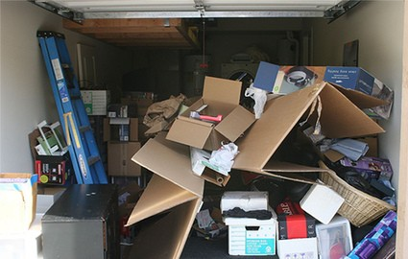
Cluttered Garage
NEXT

Slide 4
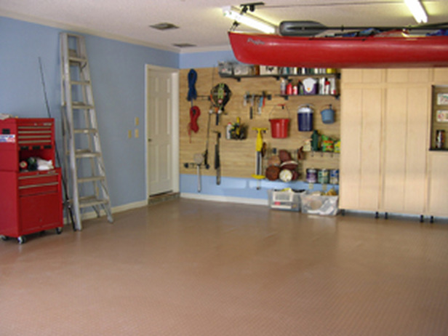
Beautiful Garage
NEXT

Slide 5
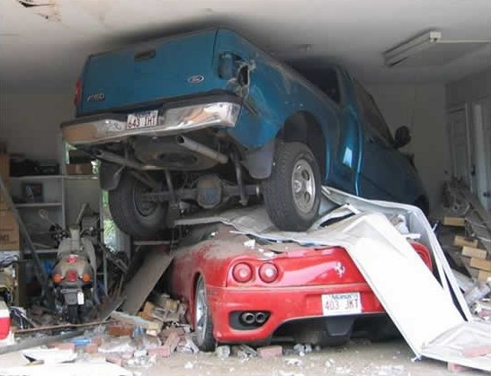
What the heck happened here?
NEXT

Slide 6
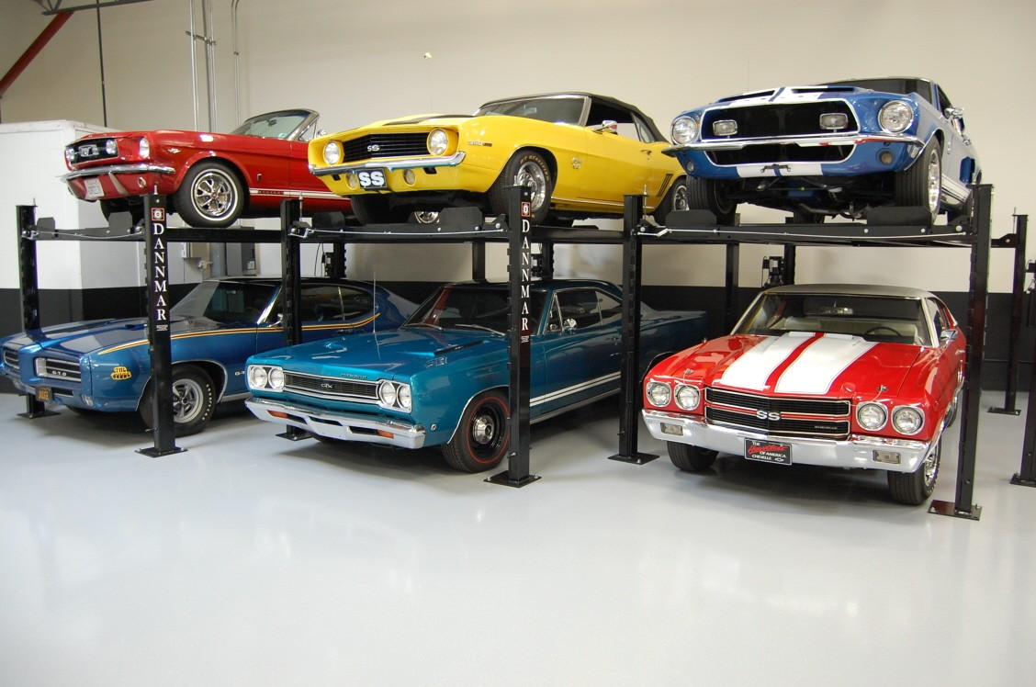
Now that’s more like it!
NEXT

Slide 7
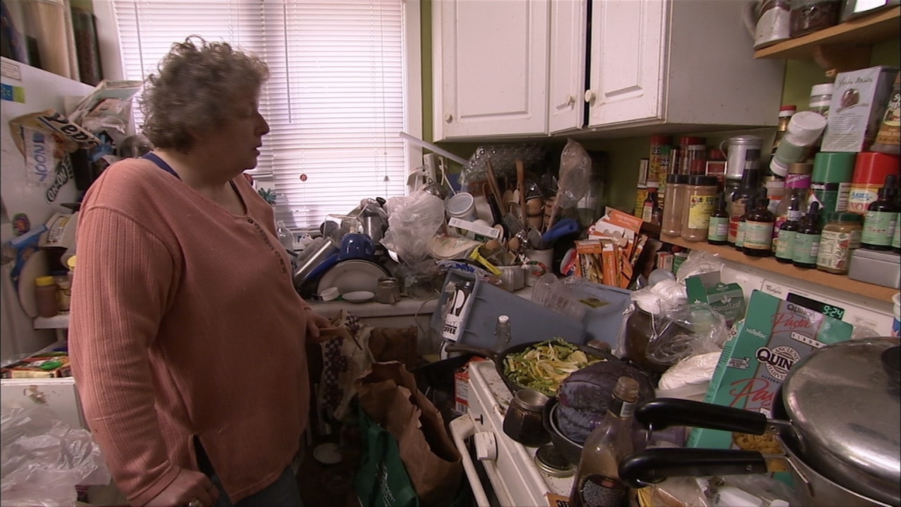
Where’s the salt and pepper?
NEXT

Slide 8
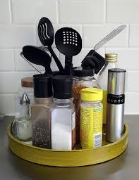
Oh, there it is. That is way easier.
NEXT

Slide 9
What’s in common with all of these photos?
A
They’re all gross
People are weird
Organization is so much better
They might be related to me
B
C
D

Slide 10
Good Job!
Just like in real life, like organizing your things, organizing files is very important.
This is called FILE MANAGEMENT Organizing your files in folders will let you find things faster, and assignments will not get lost.
NEXT

Slide 11
You almost got it…
Just like in real life, like organizing your things, organizing files is very important.
This is called FILE MANAGEMENT Organizing your files in folders will let you find things faster, and assignments will not get lost.
Try Again

Slide 12
This is why driving laws are made.
NEXT

Slide 13
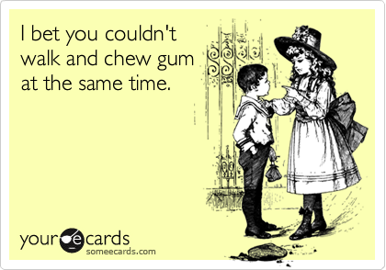
Is she only saying this because he’s a boy?
NEXT

Slide 14
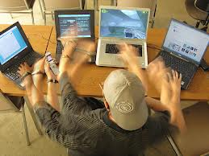
How many computers do you need?
NEXT

Slide 15
What is it called when you do two things at one time?
A
Multi-talented
Multitasking
Double Jointed
Double Trouble
B
C
D

Slide 16
Great Job!
When you use two or more programs at the same time it is called MULTITAKING
If you like to listen to Pandora, write your English Paper and have the Internet open, your are MULTITASKING.
NEXT

Slide 17
You almost got it…
When you use two or more programs at the same time it is called MULTITAKING
If you like to listen to Pandora, write your English Paper and have the Internet open at the same time, you are MULTITASKING.
NEXT

Slide 18
Review…..
MULTITASKING: Working on or running two programs at the same time
FILE MANAGEMENT: How one organizes files so they can find them easier
NEXT

Slide 19
Thank you for completing this opening activity. Please press the “esc” key and wait for Mrs. Assmus’ instructions.

