Slide 1
POWERPOINT REVIEW
Computer Technology

Slide 2
After reading the definition, think of the answer. Then, click to reveal the answer and see if you are correct.
An application software program used to create an electronic slide show
Presentation
software
OR
PowerPoint

Slide 3
After reading the definition, think of the answer. Then, click to reveal the answer and see if you are correct.
One screen in a
slide show
Slide

Slide 4
After reading the definition, think of the answer. Then, click to reveal the answer and see if you are correct.
Style and color
of slides
Design

Slide 5
After reading the definition, think of the answer. Then, click to reveal the answer and see if you are correct.
Keeping consistent style and colors throughout the slide show
Design Theme

Slide 6
After reading the definition, think of the answer. Then, click to reveal the answer and see if you are correct.
To keep a slide show professional looking and uncluttered –
Limit the # of fonts
Limit the colors
Limit the # of items on each slide
Limit the background changes
All of the above

Slide 7
After reading the definition, think of the answer. Then, click to reveal the answer and see if you are correct.
True or False –
Once you select a design theme, you must use it on every slide in the slide show
FALSE
However, remember that in order for a slide show to look professional and easy to follow, most slides in the show should have the same theme

Slide 8
After reading the definition, think of the answer. Then, click to reveal the answer and see if you are correct.
What could you select to be the background of a slide? What are your options for background?
A picture
A solid color or other fill colors
A texture
A design theme
Blank or plain white

Slide 9
After reading the definition, think of the answer. Then, click to reveal the answer and see if you are correct.
What do you click in order to open the menu allowing you to change the background of a slide?
Right click on the slide and select Format Background

Slide 10
After reading the definition, think of the answer. Then, click to reveal the answer and see if you are correct.
Placement of text and objects on a slide
Layout

Slide 11
After reading the definition, think of the answer. Then, click to reveal the answer and see if you are correct.
What menu is this picture showing?
Layout Menu

Slide 12
After reading the definition, think of the answer. Then, click to reveal the answer and see if you are correct.
A box created for you as part of a design theme or slide layout that holds a place for you to enter text and/or graphics
Placeholder

Slide 13
After reading the definition, think of the answer. Then, click to reveal the answer and see if you are correct.
Name 3 types of objects that you can INSERT
Shapes
Clipart
Pictures
Word Art
Chart

Slide 14
Identify what each letter is representing
A
What to search for
What types of media to search for (photos, clipart, sounds, etc)
Shows some of the results of the search
Clipart task pane
B
D
C

Slide 15
After reading the definition, think of the answer. Then, click to reveal the answer and see if you are correct.
This will appear on the top of each slide but only shows up on notes or handouts, not on the slides during the slide show
Header

Slide 16
After reading the definition, think of the answer. Then, click to reveal the answer and see if you are correct.
This will appear on the bottom of each slide.
Can also appear on
Only one slide
Only on notes pages or handouts
Footer

Slide 17
After reading the definition, think of the answer. Then, click to reveal the answer and see if you are correct.
If you change the inside color of an object, you are changing the
Fill

Slide 18
After reading the definition, think of the answer. Then, click to reveal the answer and see if you are correct.
If you change the border of an object, you are changing the
Outline

Slide 19
After reading the definition, think of the answer. Then, click to reveal the answer and see if you are correct.
These little circles or squares allow you to change the size of an object by clicking and dragging
Sizing handles

Slide 20
After reading the definition, think of the answer. Then, click to reveal the answer and see if you are correct.
To maintain the same proportions when resizing an object, hold down this key while using the sizing handles
SHIFT

Slide 21
After reading the definition, think of the answer. Then, click to reveal the answer and see if you are correct.
To keep the center of an object in the same place when resizing an object, hold down this key while using the sizing handles
CTRL (Control)

Slide 22
After reading the definition, think of the answer. Then, click to reveal the answer and see if you are correct.
True or False –
You cannot change the color of clipart or pictures
FALSE

Slide 23
After reading the definition, think of the answer. Then, click to reveal the answer and see if you are correct.
When you use the little green circle to turn an object you are doing what with it?
Rotating

Slide 24
After reading the definition, think of the answer. Then, click to reveal the answer and see if you are correct.
What key(s) can you hold down to allow you to select more than one object at a time?
SHIFT or CTRL

Slide 25
After reading the definition, think of the answer. Then, click to reveal the answer and see if you are correct.
Which feature allows PowerPoint to line up objects across the top, bottom, left, or right?
Align

Slide 26
After reading the definition, think of the answer. Then, click to reveal the answer and see if you are correct.
Which feature allows PowerPoint to evenly distribute space between selected objects?
Align

Slide 27
After reading the definition, think of the answer. Then, click to reveal the answer and see if you are correct.
Which feature would you select to determine which object goes in front of another?
Arrange

Slide 28
After reading the definition, think of the answer. Then, click to reveal the answer and see if you are correct.
What is the shortcut key to play a slide show?
F5

Slide 29
After reading the definition, think of the answer. Then, click to reveal the answer and see if you are correct.
What is the shortcut key to play a slide show from the currently selected slide?
SHIFT + F5

Slide 30
After reading the definition, think of the answer. Then, click to reveal the answer and see if you are correct.
What key can you press to exit a slide show at any time?
ESC (Escape)

Slide 31
After reading the definition, think of the answer. Then, click to reveal the answer and see if you are correct.
You may add NOTES about your slides at the bottom of the screen where you create the slide. Where will these NOTES appear?
Only on the
notes page view

Slide 32
Is this diagram showing Normal View or Slide Sorter View?
Normal View

Slide 33
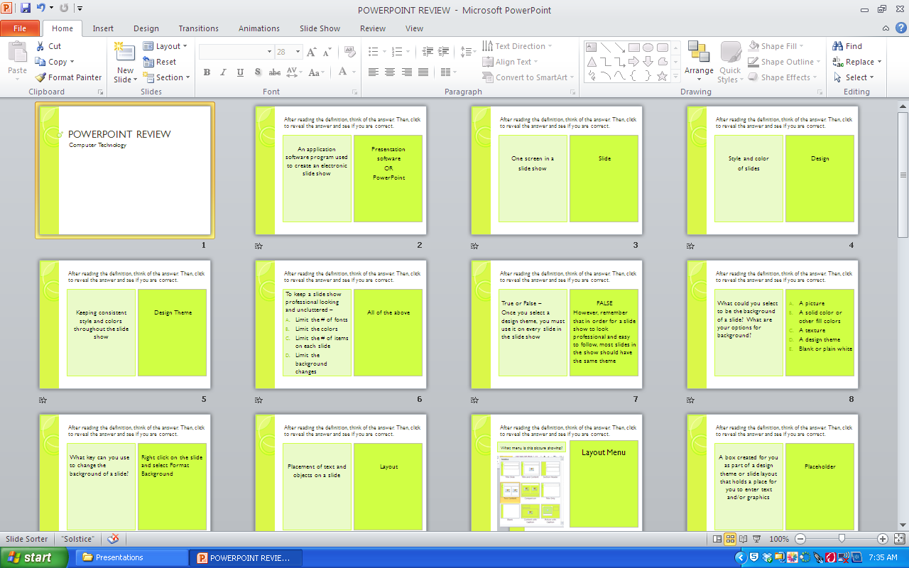
Is this diagram showing Normal View or Slide Sorter View?
Slide Sorter View

Slide 34
What view is this diagram showing?
Outline View

Slide 35
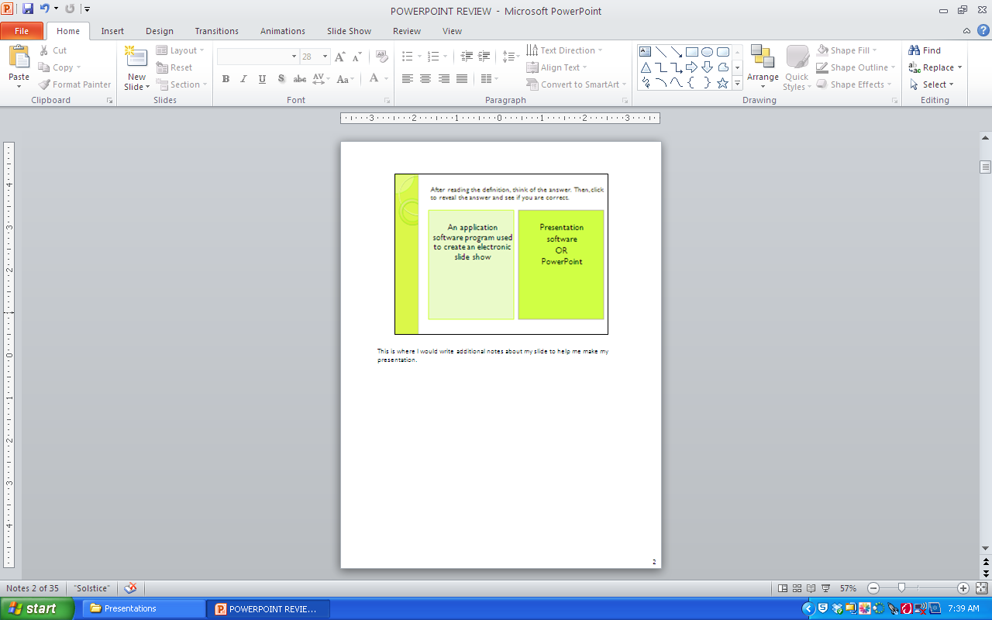
What view is this diagram showing?
Notes Page View

Slide 36
What view is this diagram showing?
Slide Show View

Slide 37
After reading the definition, think of the answer. Then, click to reveal the answer and see if you are correct.
You may move a slide when you are in which views?
Normal
Slide Sorter
Notes Pages
Slide Show
A and B
Normal and
Slide Sorter

Slide 38
After reading the definition, think of the answer. Then, click to reveal the answer and see if you are correct.
A small, visual representation of a slide or picture is called a
Thumbnail

Slide 39
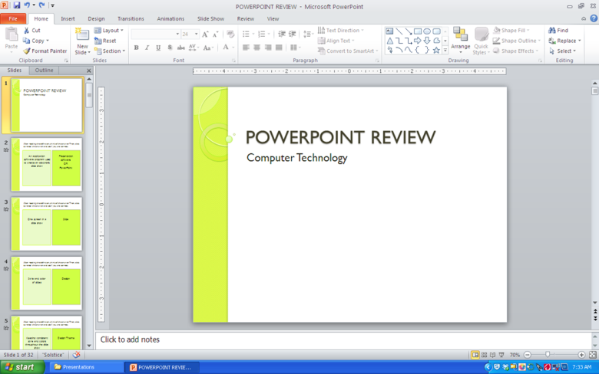
Which view(s) show thumbnails?
Normal View
Slide Sorter View
(Thumbnail)
Normal and Slide Sorter Views
Slide Show View

Slide 40
After reading the definition, think of the answer. Then, click to reveal the answer and see if you are correct.
What does it mean to duplicate a slide?
Copy a slide

Slide 41
After reading the definition, think of the answer. Then, click to reveal the answer and see if you are correct.
What feature are you using when you decide how a slide will enter the screen?
Transition

Slide 42
After reading the definition, think of the answer. Then, click to reveal the answer and see if you are correct.
What options do you have with a transition?
Fast, slow
Add sound
Change the effect of the transition

Slide 43
After reading the definition, think of the answer. Then, click to reveal the answer and see if you are correct.
What choices do you have to advance a slide?
On mouse click
OR
After so many seconds

Slide 44
After reading the definition, think of the answer. Then, click to reveal the answer and see if you are correct.
Why would you want to advance a slide show by mouse click rather than automatically?
If the presenter wants to control the amount of time spent on each slide. This allows time for discussion on the slides.

Slide 45
After reading the definition, think of the answer. Then, click to reveal the answer and see if you are correct.
True or False -
If you set one slide to automatically advance, all slides in the show must automatically advance.
FALSE
Each slide can be set with its own options.

Slide 46
After reading the definition, think of the answer. Then, click to reveal the answer and see if you are correct.
What does it mean to Insert Audio?
Insert sound

Slide 47
After reading the definition, think of the answer. Then, click to reveal the answer and see if you are correct.
What features can you add sound to?
Animation
Transition
Slide
Slide Show
Action

Slide 48
Once you have inserted your sound (the speaker icon) which tab would you click to set the options for how the sound will playback?
Audio Tools - Playback

Slide 49
After reading the definition, think of the answer. Then, click to reveal the answer and see if you are correct.
Adding an effect to text or objects
Animation

Slide 50
After reading the definition, think of the answer. Then, click to reveal the answer and see if you are correct.
Which feature controls the order of things entering a slide?
Transition
Action
Animation
C - Animation

Slide 51
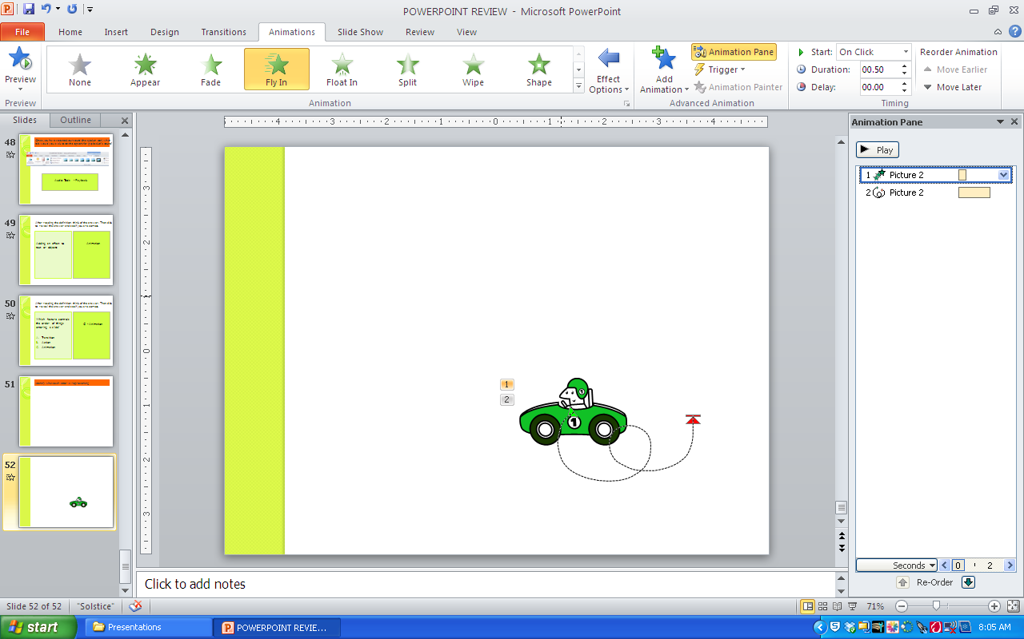
Identify what each letter is representing
G
A
B
C
D
E
F
Clip art - H
Custom animation pane - J
Add a trigger - F
Preview the animation - A
When the animation will start - G
Add more than one animation to an object - E
Type of effect - B
Change the effect options - C
Motion path of the effect - I
Additional effect options - D
Clip art
Custom animation pane -
Add a trigger -
Preview the animation -
When the animation will start -
Add more than one animation to an object -
Type of effect -
Change the effect options -
Motion path of the effect -
Additional effect options -
H
J
I
Click here to reveal answers

Slide 52
After reading the definition, think of the answer. Then, click to reveal the answer and see if you are correct.
If I click on an item on one slide and it takes me to another slide, what function am I using?
Action

Slide 53
After reading the definition, think of the answer. Then, click to reveal the answer and see if you are correct.
Text or an object that has been set to link or connect me to another slide
Hyperlink

Slide 54
After reading the definition, think of the answer. Then, click to reveal the answer and see if you are correct.
When inserting an action on an item, I pick from two choices the user can use to activate the action. What are the two choices?
On mouse click
OR
On mouse over

Slide 55
According to this diagram, what will print?
All slides – one per page
Slides 1, 3, and 4
Handouts – 6 per page
Notes Pages

Slide 56
According to this diagram, what will print?
All slides – one per page
Slides 1, 3, and 4
Handouts – 6 per page
Notes Pages

Slide 57
According to this diagram, what will print?
All slides – one per page
Slides 1, 3, and 4
Handouts – 6 per page
Notes Pages

Slide 58
THE END
Click here to start again

