Slide 1
Computer Technology
Standard 1 - Basics
Standard 2 – Word Processing
Standard 2 - Spreadsheets
Standard 2 - Presentations
Standard 2 – Databases
Semester Test Review
Standard 3 – Internet/
Software Licenses
Standard 4 – Elec. Comm.

Slide 2
Spreadsheets
Review

Slide 3
Excel/Spreadsheets
Basics
Cell: Where a row and column intersect
Worksheet: One page in a workbook
Directions
Columns:
  Labeled: A, B, C, D
  Run Vertical (up and down)
Rows:
  Labeled: 1, 2, 3, 4
  Run Horizontal (left and right)

Slide 4
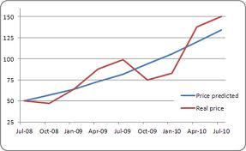
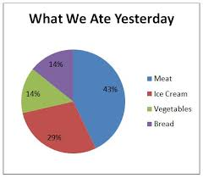
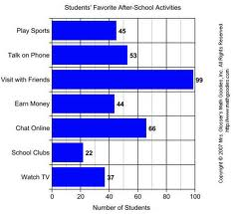
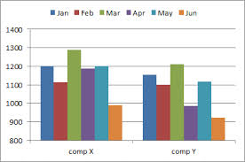
Excel Charts
Line Chart
Pie Chart
Column Chart
Bar Chart

Slide 5
When do you use a certain chart?
Bar chart: Compare multiple values
  Use of electricity throughout the different months (Horizontal bars)
Column chart: Compare values across categories
  Use of electricity throughout the different months (Vertical bars)
Line chart: Display trends over time
  How many tardies each quarter
Pie chart: Display one value to a whole
  How many 7th, 8th, and 9th graders in the school

Slide 6
Legend/Key
Key for interpreting the chart’s colors, patterns, etc.
Legend

Slide 7

Filtering/Sorting
Sorting: Sorts all information in ascending/descending order
  Ascending: A to Z; 1 to 10
  Descending: Z to A; 10 to 1
Filtering: Shows information that meets a certain criteria
  Example:
    Only showing students with an average score of 80%
    Only showing clients with the last name starting with “D”

Slide 8
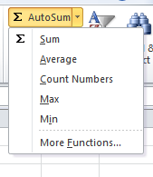
Formulas/Functions
Formula/Function always starts with =
AutoSum: includes the 5 most
common functions
AutoSum Functions
SUM: adds numbers
AVERAGE: average of a range
COUNT: counts #s/items used
MAX: finds biggest number in range
MIN: finds smallest number in range
Mathematical Symbols
Add: +
Subtract: -
Divide: /
Multiply: *

Slide 9
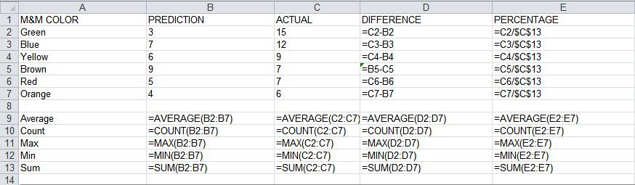
Relative/Absolute Addresses
Relative: cell reference changes as the formula is copied
Absolute: cell reference does not change as the formula is copied ($)
Absolute Addresses
Relative Addresses

Slide 10
Formula/Functions
Formulas: equations that preform calculations on values in a worksheet
Functions: predefined formula that performs a calculation in a worksheet
Formula | Function
=B2*B3 | =SUM(A3:D6)
=A1+B1+C1 | =AVERAGE(C3:C7)
=B10/D5 | =COUNT(F3:F10)
=B2*(C5-C4) | =MAX(A5:A8)
=F4-D4 | =MIN(B6:B12)

Slide 11
Formatting Numbers
Formatting | What it looks like
Percentage | 100%
Currency | $100.00 $1.25
Accounting | $ 100.00 $ 1.00
Date | 10/12/2013

Slide 12
Databases
Review

Slide 13
Database Icons
First
Record
Previous Record
Next Record
Last Record
New Record

Slide 14
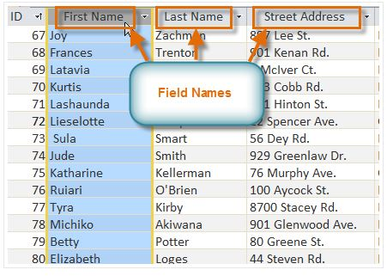
Basic Terminology
Field: category of information for which data is given in each individual record

Slide 15
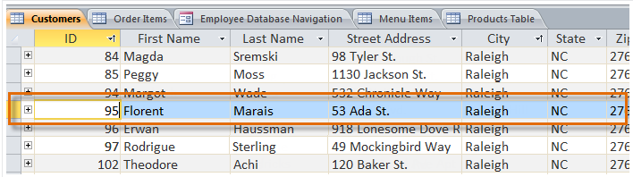
Basic Terminology
Record: all the information for one particular item in the database file

Slide 16
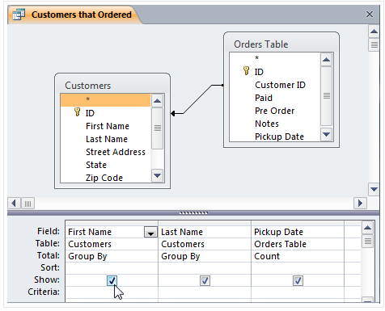
Basic Terminology
Query: a process(search) used to locate all records that satisfy a statement, rule, or criterion

Slide 17
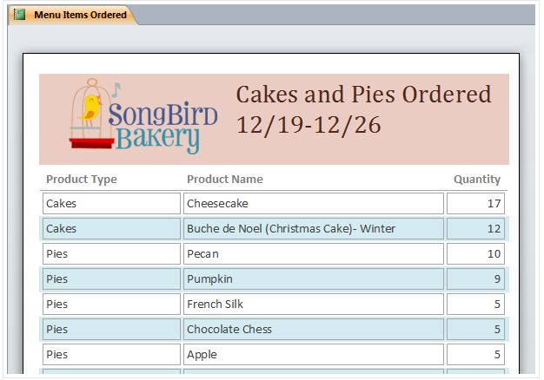
Basic Terminology
Table: a collection of associated records

Slide 18
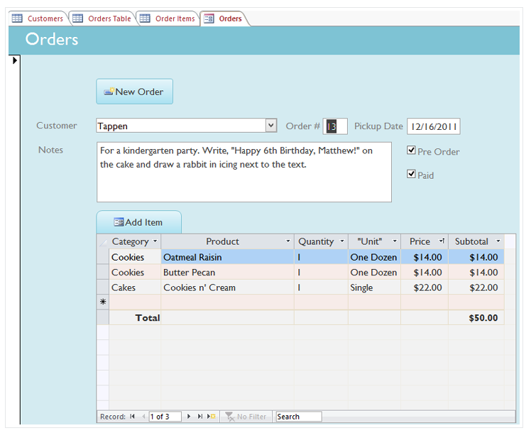
Basic Terminology
Form: displays data from one or more tables or queries in a format that has a similar appearance to a paper form

Slide 19
Internet/Software Licenses
Review

Slide 20
Internet
Global network of networks
  Internet is the largest WAN (wide area network)
WWW
  World Wide Web
HTML
  Programming language of the web

Slide 21
URL/Domains
URL (Uniform Resource Locator): address of a website, web page, or file on the web
  Example:
    http://www.cnn.com
Website Domains
.com | Commercial
.edu | Educational
.gov | Government
.int | International
.net | Network
.org | Non-profit organization

Slide 22
Hypertext Links
A word, phrase, or picture that links or connects you to another website
Useful so you don’t have to memorize a long web address
Hypertext links are usually blue with an underline

Slide 23
Web Browsers vs. Search Engines
Web Browser
Application program that allows you to view information on the web
Examples: Internet Explorer, Google Chorme, FireFox, Safari
Search Engines
Specialized websites that help you find what you’re looking for on the web
Examples:
Yahoo, Google, Bing, Ask, AOL

Slide 24
Boolean Operators
To narrow down internet searches, use BOOLEAN OPERATORS
Boolean operators:
  AND/+ (peanut AND butter) (peanut + butter)
  OR (peanut OR butter)
  NOT/- (peanut NOT butter) (peanut – butter)
  * (used as a wild card)

Slide 25
Acceptable Use Policy (AUP)
Guidelines on how a network can and should be used.
  Every school year you sign a AUP before you can login to a school computer.

Slide 26


Copyright
The rights processed by the owner of information or resources
Once property is tangible (recorded in some way) it is copyrighted
A thought CANNOT be copyrighted
Trademark
Protecting a name, symbol, or logo so that others can’t use it

Slide 27




No copyright, free to all
Public Domain
Copyrighted but free
Freeware
Copyrighted with use restrictions
Shareware
Copyrighted, at a cost, all restrictions possible
All Rights Reserved
Copyrighted, restrictions stipulated by creator. Free to share.
Creative Commons

Slide 28
Plagiarism
Ethics
Principles that guide behavior
Right or Wrong
Not everyone ethics are the same
Copying someone else’s work and claiming it as your own or not giving proper credit to the owner
How to Protect Yourself?
Use footnotes/endnotes
Use Bibliography/Works Cited

Slide 29
Electronic Communication
Review

Slide 30
Email Basic Terminology
Attachment
  Electronic file/photo sent with an email message
    A paper clip represents the icon for an attachment
CC
  Courtesy copy
    Example: Sending email to parent might send the vice principals a courtesy copy so they know what is going on
BCC
  Blind copy
  The person you are sending the email to does not know you sent it to the person in the BCC

Slide 31




Email Icons
Insert link
Get email
Attachment
Emoticons

Slide 32
Reply vs. Reply All
Reply
  Sends only to the person who sent the email
Reply All
  Sends to everyone who was sent the email

Slide 33
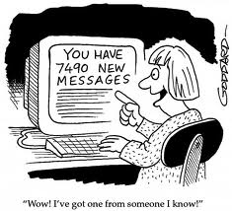
Spam vs. Junk Mail
SPAM
Irrelevant or inappropriate messages sent on the Internet
Junk Mail
Unsolicited advertising or promotional material received though email
Many are sent with malicious intent

Slide 34
Netiquette
Proper etiquette to use with electronic communication
  Some proper email etiquette:
    DON’T TYPE IN ALL CAPS
    Use a Subject Line
    KISS (Keep it short & simple)

Slide 35
PowerPoint
Review

Slide 36
Layouts
Placement of text and objects on the slide
Layout Options:
  Title Slide
  Title and Content
  Section Header
  Two Content
  Comparison
  Title Only
  Blank
  Content with Caption
  Picture with Caption

Slide 37
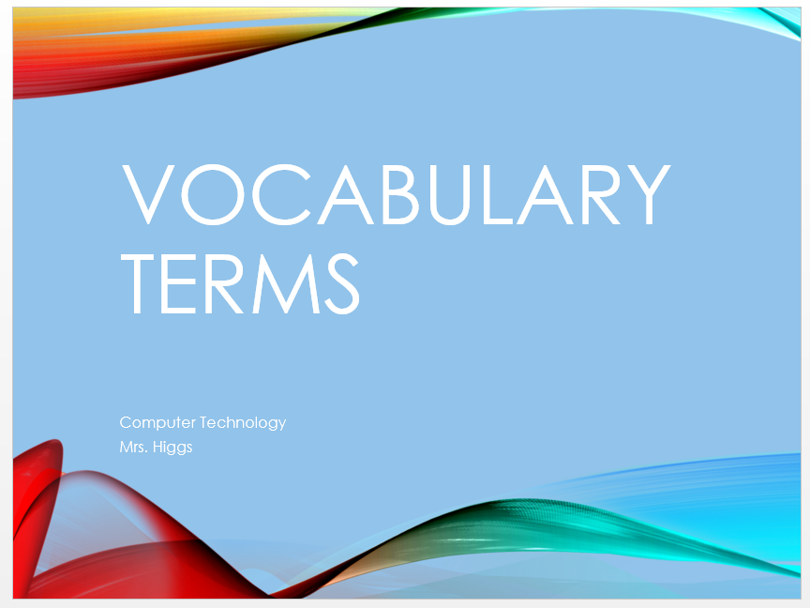
Title Slide Layout
Use this layout to create the “cover page” of your presentation
Usually tells
  Title of what you are presenting
  Name of presenter
  Date
Example of a Title Slide in a presentation

Slide 38
Title and Content Layout
This layout is typically used when you are discussing a specific topic
Can include:
  Bullets
  SmartArt
  Table
  Chart
  Video
  Pictures/Online Pictures
This slide is an example of a Title and Content Layout in a presentation

Slide 39
Two Content Layout
This slide layout is used to show two types of content
It can include
  Text and one of the following:
    Table
    Chart
    SmartArt
    Picture/Online Picture
    Video
Home Ribbon
Slide Group
Layout Icon

Slide 40
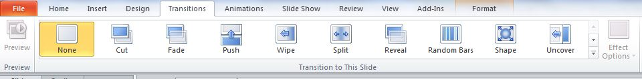
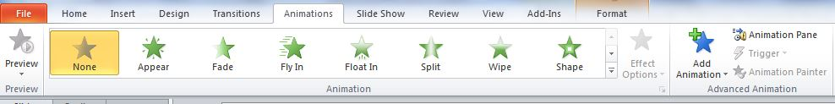
Transitions
How the ENTIRE slide will enter the screen
Animations
Adding movement or an effect to text or objects within a slide

Slide 41
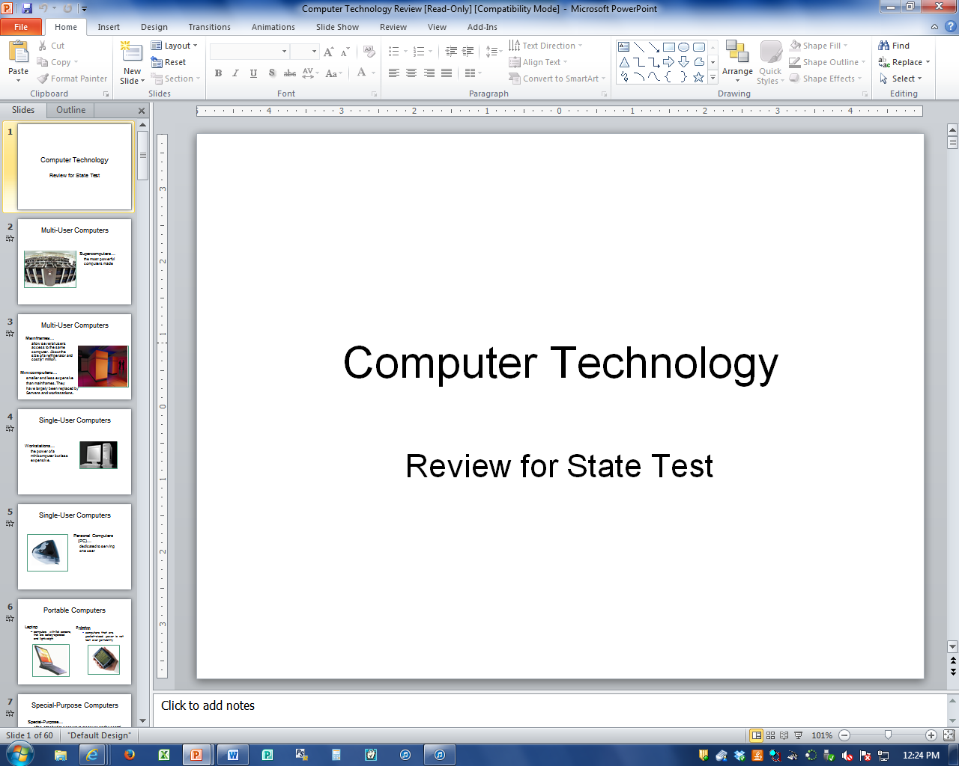
Normal View
What it looks like when you are creating the PowerPoint

Slide 42
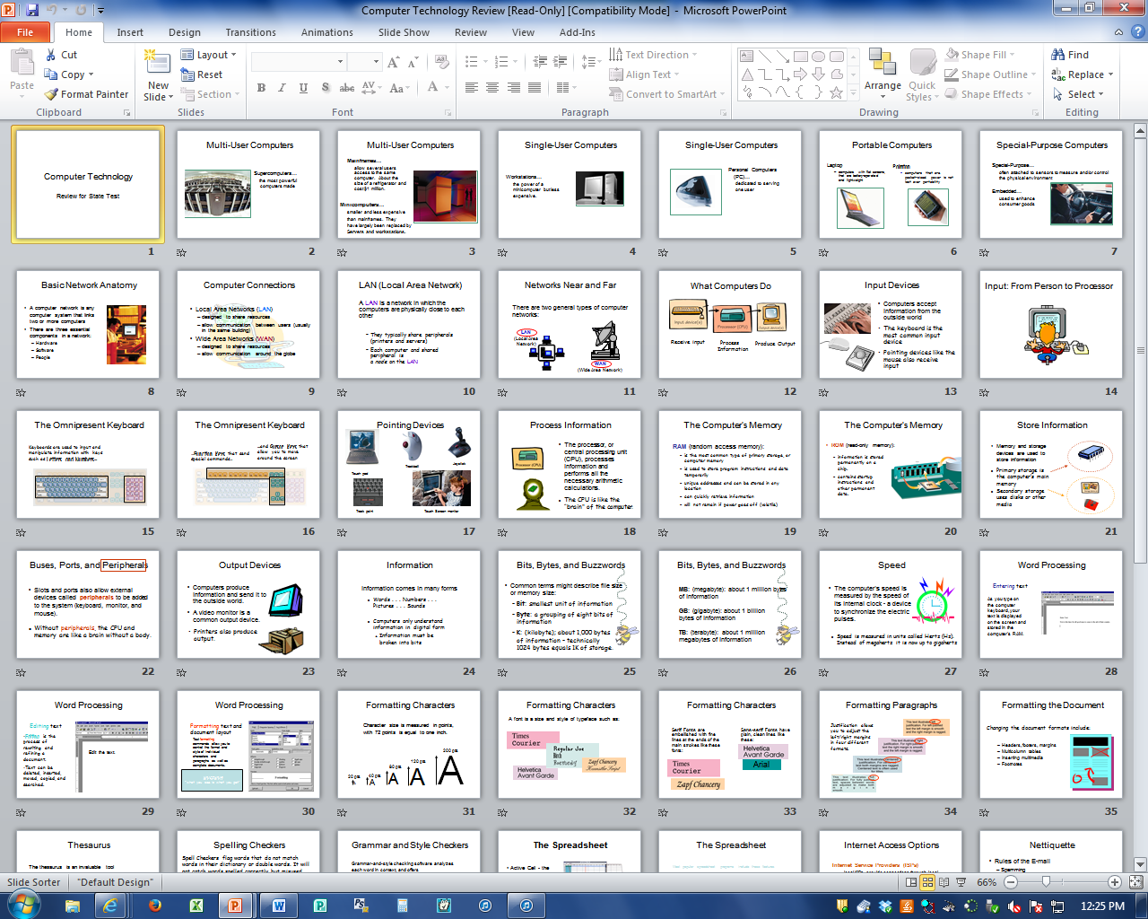
Slide Sorter
Small, visual representation of the slides

Slide 43
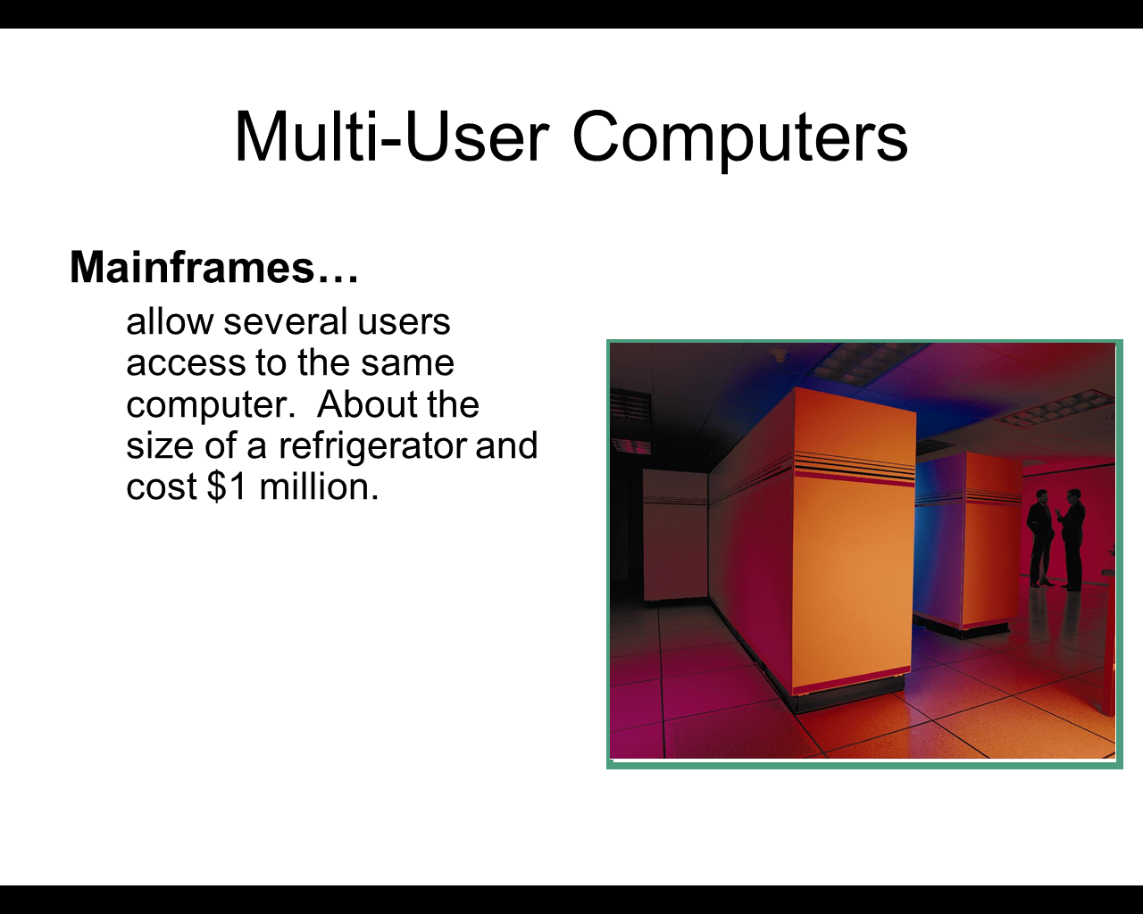
Slide Show View
How it is presented to a group; one slide at a time

Slide 44
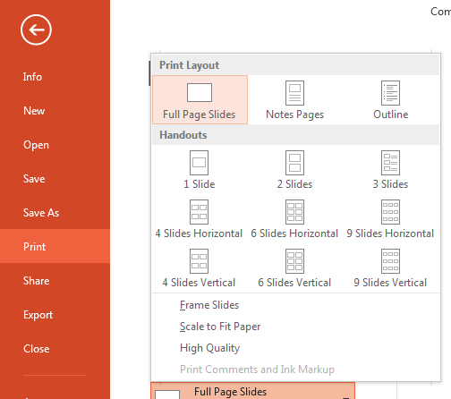
Printing PowerPoints
Printing Options:
  Outline
  Handouts (print several slides on one page)
  Slides
  Slide Thumbnails with notes

Slide 45
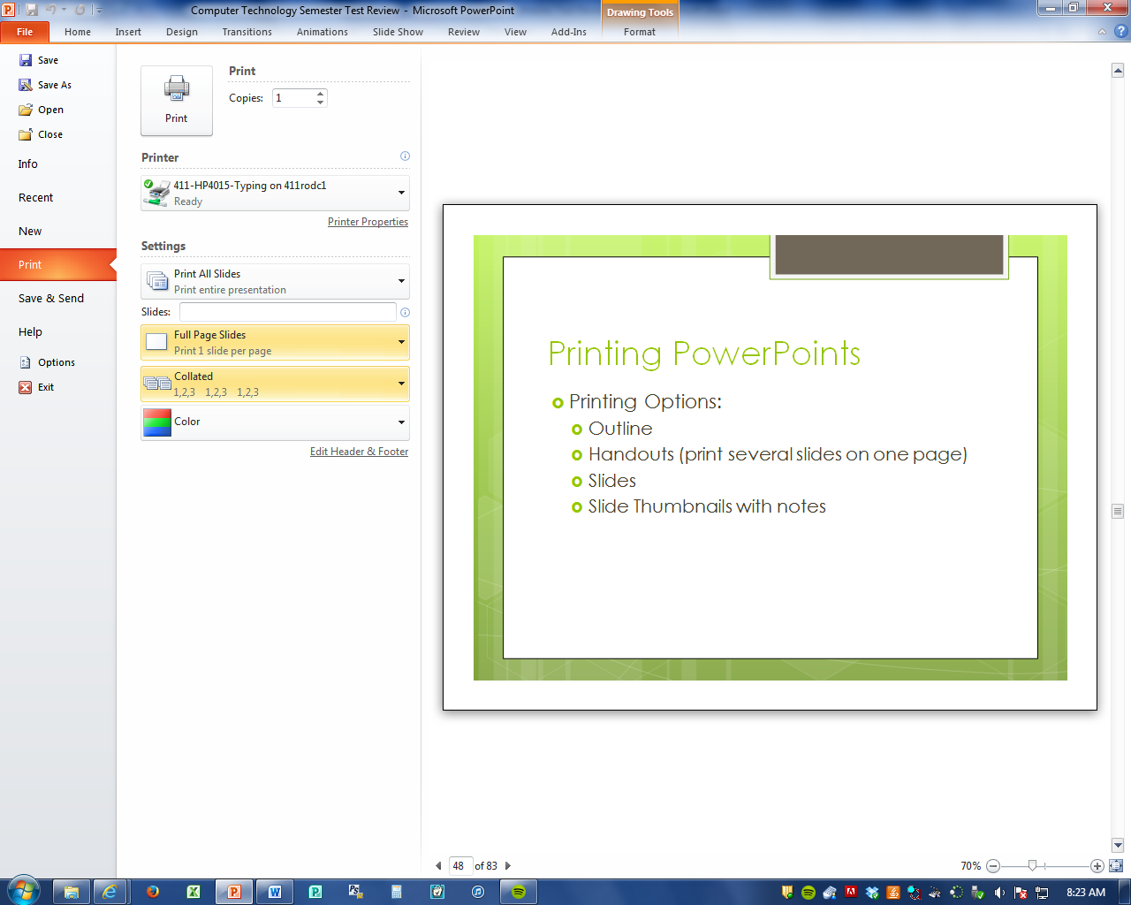
Full Slide Printing

Slide 46
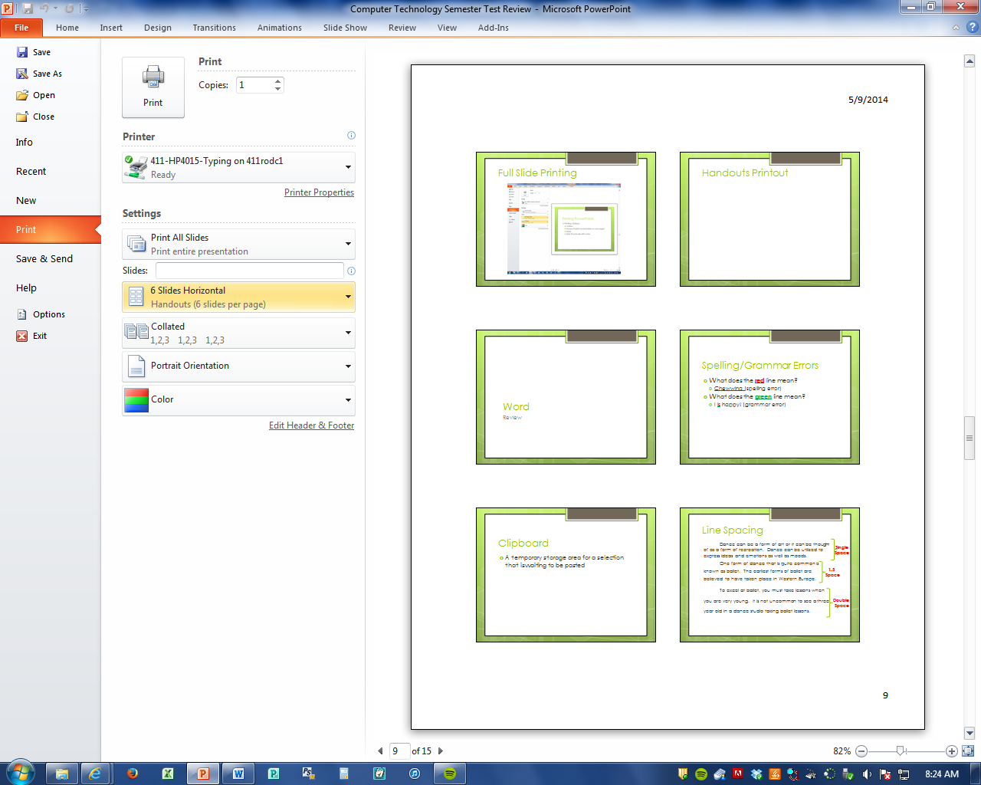
Handouts Printout

Slide 47
Word Processing
Review

Slide 48
Spelling/Grammar Errors
What does the red line mean?
  Chewwing (spelling error)
What does the green line mean?
  I is happy! (grammar error)

Slide 49
Clipboard
A temporary storage area for a selection that is waiting to be pasted

Slide 50
Line Spacing
Dance can be a form of art or it can be thought of as a form of recreation. Dance can be utilized to express ideas and emotions as well as moods.
One form of dance that is quite common is known as ballet. The earliest forms of ballet are believed to have taken place in Western Europe.
To excel at ballet, you must take lessons when you are very young. It is not uncommon to see a three year old in a dance studio taking ballet lessons.
Single Space
1.5
Space
Double
Space

Slide 51
Alignment
Dance can be a form of art or it can be thought of as a form of recreation. Dance can be utilized to express ideas and emotions as well as moods.
One form of dance that is quite common is known as ballet. The earliest forms of ballet are believed to have taken place in Western Europe.
To excel at ballet, you must take lessons when you are very young. It is not uncommon to see a three year old in a dance studio taking ballet lessons.
In addition to starting at a very young age, hours and hours of practice are also required to develop into a skilled performer of ballet.
Left
Align
Right Align
Center Align
Justify Align

Slide 52
Formatting
This text has no formatting to it.
This text has bold formatting.
This text has italic formatting.
This text has underline formatting.
Notes:
Speaker notes.

Slide 53
Word Wrap
Word wrap is when the computer automatically sends the text to the next line WITOUT hitting Enter.
  Also known as soft return.
Pressing the ENTER key is a HARD RETURN

Slide 54
Indents
First Line Indent Example
Dance can be a form of art or it can be thought of as a form of recreation. Dance can be utilized to express ideas and emotions as well as moods.
Hanging Indent Example
One form of dance that is quite common is known as ballet. The earliest forms of ballet are believed to have taken place in Western Europe.

Slide 55
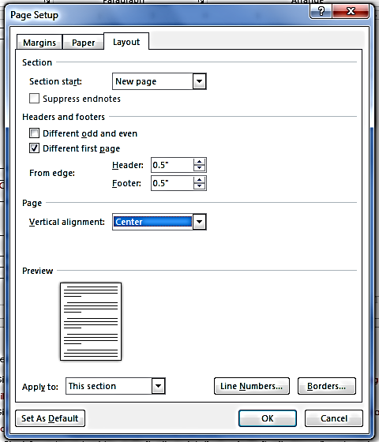
Vertical Alignment
Center the text in your document vertically instead of horizontally
There is the same about of “white space” on top of your document as well as bottom
  Page Layout > Page Setup launcher > Layout tab > Vertical alignment

Slide 56
Lists
Numbered List | Bulleted List | Multi Level List
Apples Oranges Bananas Pineapple | Apples Oranges Bananas Pineapple | Fruits a. Apples i. Green ii. Red b. Banana Veggies a. Carrots b. Peas

Slide 57
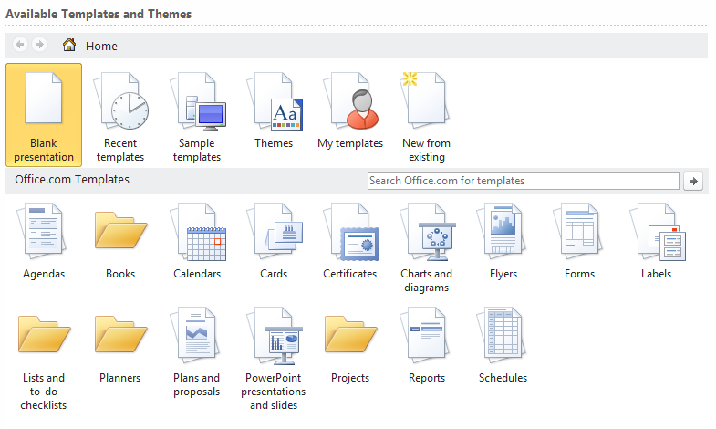
Template
A document that provides structure for commonly used Business documents.
  Calendars
  Cards
  Agendas
  Forms
  Certificates
  Fax Covers
  Etc.

Slide 58
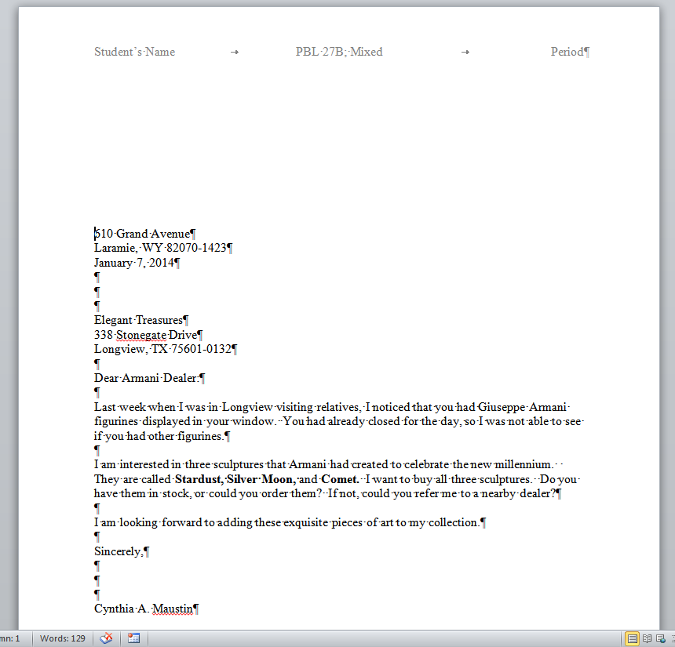
Non-Printing Characters
Home
Paragraph
¶
→ = Tab
¶ = Paragraph
· = Space

Slide 59
Basics
Review

Slide 60
CPU
Central Processing Unit
“Brain” of the computer
Where all the processing of a computer takes place

Slide 61
LAN vs. WAN
LAN (Local Area Network)
Computers and devices connected within a confined space
  Examples: SJMS, Office Building
WAN (Wide Area Network)
Multiple computers connected over a large geographical area
  Examples: Internet, Jordan School District

Slide 62
RAM vs. ROM
RAM (Random Access Memory)
Temporary storage used when the computer is on.
RAM is VOLATILE
  Information is lost when the computer is turned off
ROM (Read Only Memory)
Used in the boot process that stores permanent instructions for the computer

Slide 63
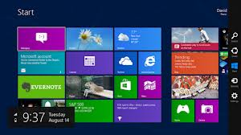
Operating System
Software that produces communication between the user, the application software and the hardware
Controls the overall functions of the computer
  Examples
    Windows 7
    Windows Vista
    Windows XP
    Windows 98
    Windows 95

Slide 64

Network
Two or more computers/devices connected together to communicate or share information

Slide 65
Input Devices
Units that gather information and transform that information into a series of electronic signals for the computer.
Output Devices
Devices that display, print, or transmit the results of processing from the computer’s memory.

Slide 66
Input/Output Devices
Input Devices
Output Devices
Keyboard
Mouse
Scanner
Microphone
Monitor
Printer
Speakers
Projector

Slide 67
Peripheral Devices
Devices used to expand the computers input, output, and/or storage capabilities.
Examples of
Peripheral Devices
Webcam
External Hard Drive
Microphone
Scanner
Modem
Digital Camera

Slide 68
Storage Devices
A device used to store data when the computer is turned off
  Examples
    CD/DVD
    Hard Disk
    Flash Drive
    External Hard Drive
    Cloud

Slide 69
Save vs. Save As
Save
Save As
Save in the same location
Save with the same document name
Can choose what location to save as
Can choose what to save the document name as

Slide 70
Memory Size
Name | Size
Bit | 0 or 1
Byte | 8 bits
Kilobyte | 1,000 bytes
Megabyte | 1 million bytes
Gigabyte | 1 billion bytes
Terabyte | 1 trillion bytes

Slide 71
Hardware vs. Software
Hardware
Software
Any part of the computer that has physical structure
Includes all of the computer’s internal parts
Set of instructions that tells the hardware what to do
Instructs the hardware how to accomplish each task

Slide 72
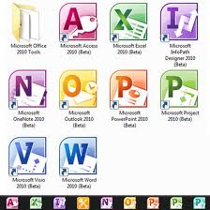
Application Software
Software designed to help you carry out a specific task
Examples:
  PowerPoint
  Word
  Excel
  Publisher

Slide 73
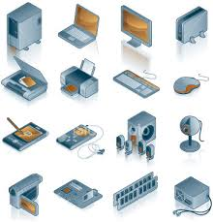
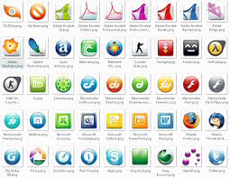
Hardware vs. Software
Hardware
Software

Slide 74
Troubleshooting
CTRL + ALT + DELETE
Restart
Too many large tasks running at a time slows down a computer
Multi-tasking – Making sure that the instructions and data from one area of memory don’t interfere with memory allocated for other programs.

Slide 75
Types of Computers
Review

Slide 76
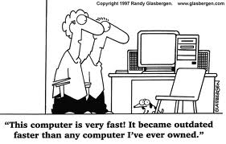
Speed of a Computer
The speed of a computer is measured in hertz
  Megahertz (MHz)
  Gigahertz (GHz)

Slide 77
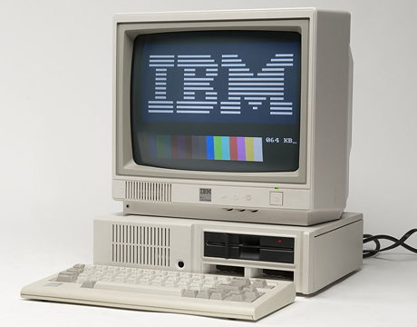
Microcomputer
A personal computer; designed to meet the needs of an individual.
Provides access to a wide variety of computing applications, such as word process, photo editing, e-mail, and internet.
IBM Personal Computer
(1983)
Tidbit: In common usage, "microcomputer" has been largely replaced by the term personal computer or PC, which meant to be used by one person at a time. IBM first promoted the term "personal computer" to differentiate themselves from other microcomputers.

Slide 78
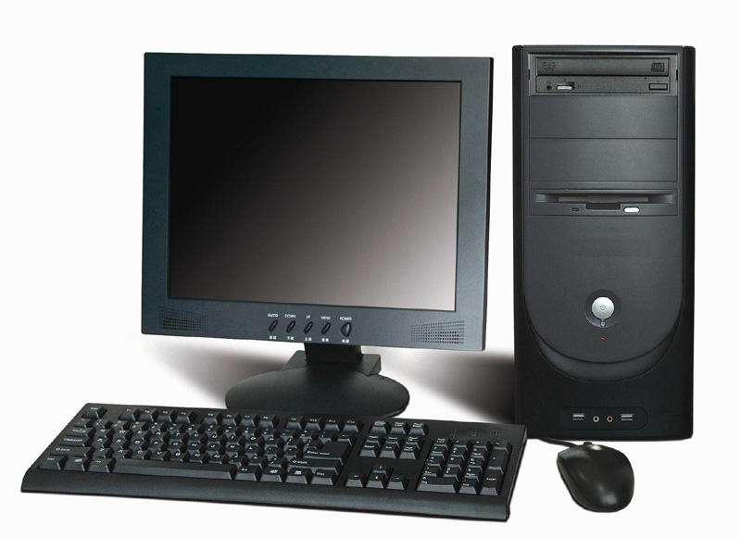
Desktop Microcomputer
CPU is located inside the system unit.
A microcomputer that fits on a desk and runs on power from an electrical wall outlet.
The CPU can be housed in either a vertical or a horizontal system unit.
Separate components (keyboard, mouse, etc.) are each plugged into the computer.

Slide 79
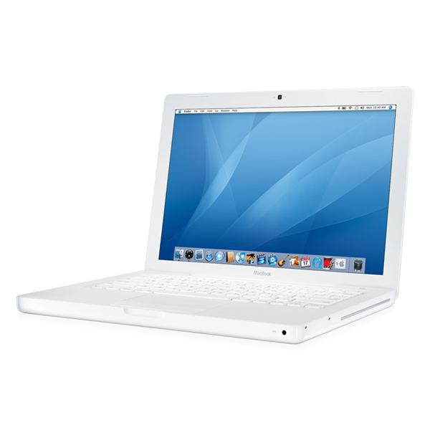
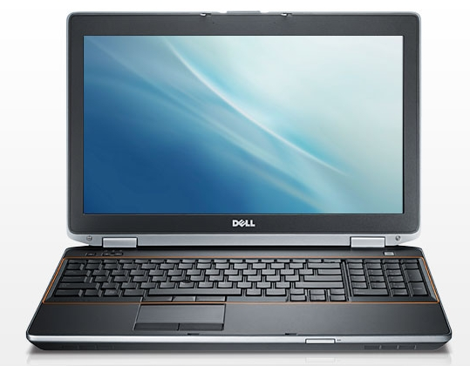
Laptop {Notebook} Computer
A portable, compact computer that can run on an electrical wall outlet or a batter unit.
All components (keyboard, mouse, etc.) are in one compact unit.
Usually more expensive than a comparable desktop.
Sometimes called a “Notebook”.
Mac (Apple) Laptop
PC (Windows) Laptop

Slide 80
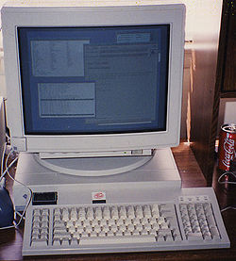
Workstation
Powerful desktop computer designed for specialized tasks.
Can tackle tasks that require a lot of processing speed.
Can also be an ordinary personal computer attached to a LAN (local area network)
Sun SPARCstation
(early 1990s)

Slide 81
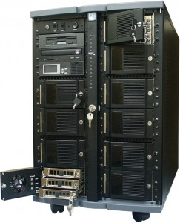
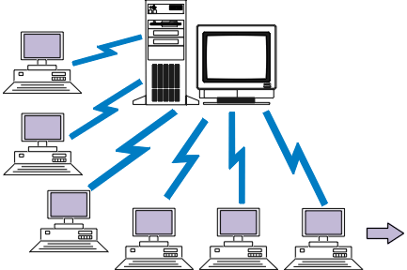
Server
Purpose is to “serve”
A computer that has the purpose of supplying its users with data; usually through the use of a LAN (local area network)

Slide 82
Viruses
Review

Slide 83
Malware
One of the most common types of computer threats
Malicious software that hackers use to gain
  Unauthorized access to computers
  Steal private information
  Disrupt computer operations
Most common malware attacks involve viruses, Trojan horses, worms, spyware, and adware
Hackers are people who “hack” or break into a computer systems through unauthorized means.

Slide 84
Computer Virus
Set of program instructions that attaches itself to a file, reproduces itself, and/or spreads to other files
Written to alter the way a computer
operates without the permission or
knowledge of the user
Usually spread through downloads and
email attachments
Viruses require human action (such as downloading a file or clicking on a link in an email) to spread

Slide 85
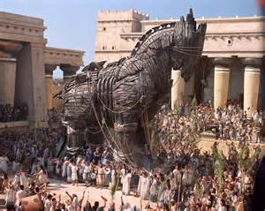
Trojan Horse
Computer program that seems to perform one function while actually doing something else
Users unknowingly download/install or run them because they are attached to software or files that are legitimate or look legitimate
Trojan horses can
  Steal data
  Download files
  Crash an operating system
The term Trojan horse can be traced back to the story of the Trojan War in Greek mythology. It refers to a giant hollow wooden horse Greek warriors hid in order to sneak into the city of Troy.

Slide 86
Worm
Enters through a computer network through security holes
Replicate themselves from system to system
Type of damage caused by worms:
  Use up bandwidth
  Slowing down or crashing servers or
  individual computers
Unlike viruses, worms don’t need human action in order to spread.

Slide 87
Spyware
Collects information without the knowledge of the computer user
Attached to software or files (such as music files) that a user wants
Similar to Trojan horses
  Record keystrokes
    Internet searches
    Log-in information
    Passwords
    Bank account information
Most spyware is used for illegal purposes
Some companies intentionally install spyware on shared business computers to monitor employee computer use

Slide 88
Adware
Advertising software intended to make money for the creator of the advertisement
Often comes with free software (freeware)
Can sometimes come with spyware
When you see advertisements relevant to your recent web searches, this is an example of spyware and adware at work

Slide 89
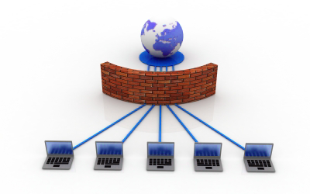
Firewall
Stands between your computer’s network and the Internet, helping to protect your computer from unauthorized access to your network
Example: SJMS has a firewall to protect students from visiting inappropriate website and from receiving harmful emails (spam)

Slide 90




Cookies
You do an online search for longboards
A small file that identifies you as a unique user of a website
Your search brings up longboards.com. You click on the link and visit the site
As you click through various longboards, more information is stored to the cookie, tracking what you are clicking on.
When you land on the site, a cookie is immediately downloaded from the site to your computer.

Slide 91
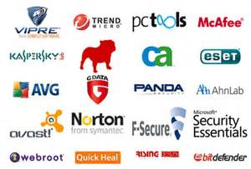
Antivirus Software
Software that searches for and removes any malware
Prevents malware from attaching to your computer and keeps viruses, worms, and Trojan horses safely away from your files and applications

