Slide 1
Software

Slide 2
Computing History Milestones
1946 | first large-scale electronic computer
1951 | one of the first commercial computers
1963 | Computer mouse developed
1965
1977
1981
ENIAC
Univac
Minicomputers
Apple PCs introduced
IBM PCs introduced

Slide 3
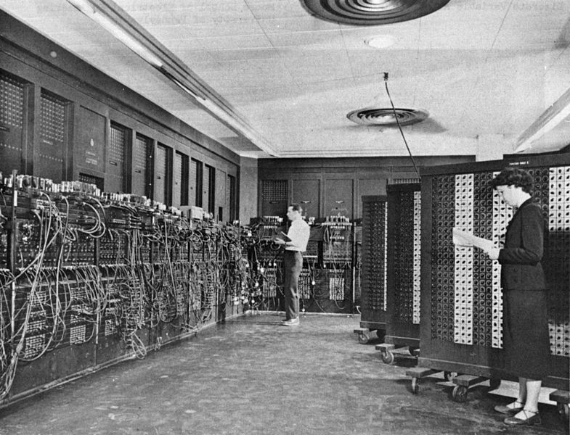
ENIAC Stats
Announced in 1946 it was heralded in the press as a "Giant Brain“
Cost almost $500,000 (approximately $5,900,000 today)
A tube failed about every two days would locate the problem within 15 minutes
In 1954, the longest continuous period of operation without a failure was 116 hours—close to five days.
Could perform 5,000 simple addition or subtraction operations

Slide 4
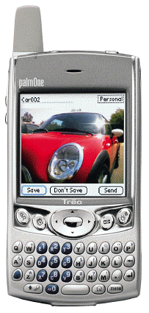
Computing History Milestones
1983 | Notebook computers introduced
1984 | computers introduced Mouse and icons became important tools
1991 | World Wide Web was developed Internet use began to grow rapidly
1993 | PDAs (handheld computers) introduced
2001 | Tablet PCs introduced
Present | Handheld computers, smart phones, and other computers are becoming smaller and more powerful
Macintosh
Lesson 10

Slide 5
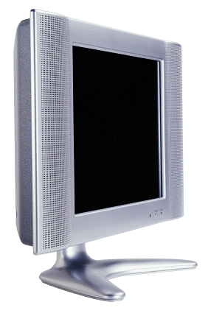
The PC Race
The space industry’s need for computers led to
Smaller computers
Faster computers
More powerful computers
Computers in common devices
Flat Screen TV
©GettyImages/PhotoDisc
Lesson 10

Slide 6
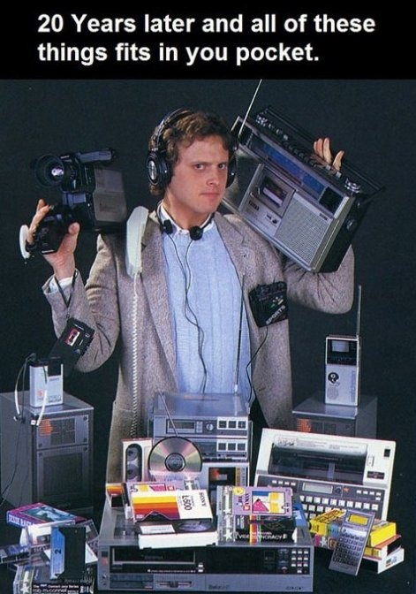
20 years later and all of these
things fit in your pocket.

Slide 7
Communicating with Computers
How do you use the computer to communicate?

Slide 8
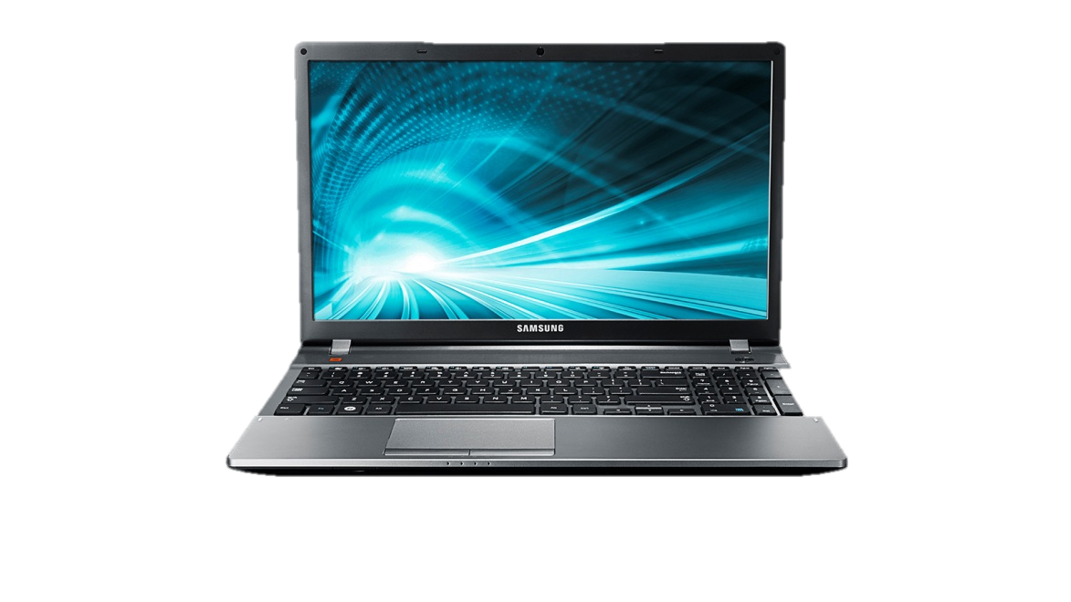
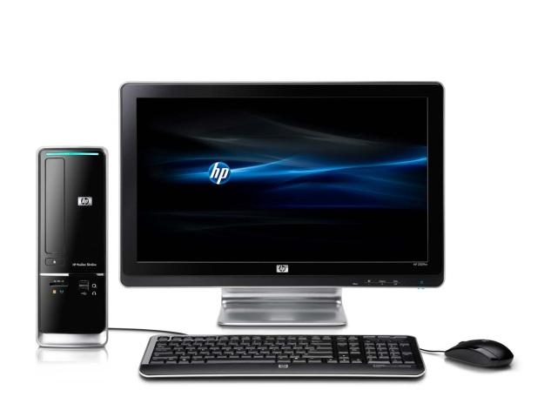
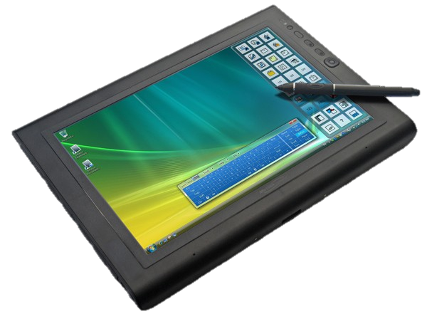
Personal Computer
A small computer designed for an individual user
Examples
Desktop model
Laptop
Tablet PC
Others?

Slide 9
Other types of Computers
Supercomputers: Process very large amounts of information (1 quadrillion mathematical computations per second)
Predicts weather such as hurricanes
Military
Doplar
Mainframes
Used by government, businesses, and researchers to process very large amounts of information.
Microprocessor
A silicon chip that contains a CPU. Control the logic to almost all digital devices

Slide 10
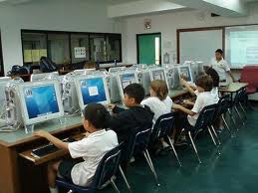
Networks
Computers linked to one another
LAN – Local Area Network
Network of computers covering a small area.
Home, office, school

Slide 11
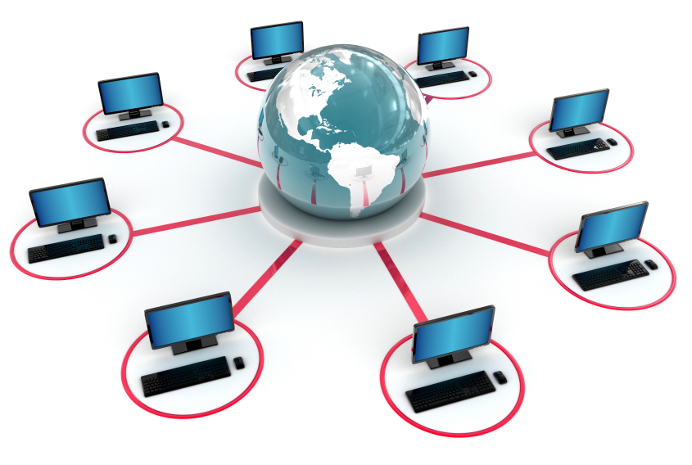
Networks
WAN (Wide Area Network)
Network of computers covering a broad area
(National, International)
THE INTERNET

Slide 12
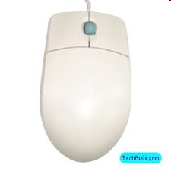
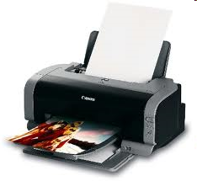
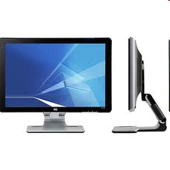
Hardware: the physical parts of a computer or device

Slide 13
Software: programs that give instructions to the computer or device
2 Types of Software:
Operating system software
2. Application programs

Slide 14
Operating System Software
Controls the basic operations of the computer
Most important software on a computer
Controls the hardware
Allows application programs to run
Gives important messages about the computer
Ex: Microsoft Windows XP, Windows 7, etc.

Slide 15
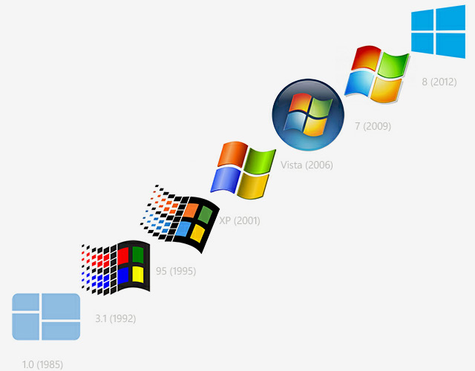
Microsoft Windows
Provides ready made solutions that can be used by just about everyone
Almost 100% compatible with any file or document created in America
Not always as stable as Apple (OS X)
95% of viruses come from computers using Windows or Microsoft

Slide 16
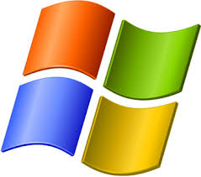
Recent Versions of Microsoft Windows (since 1995)
Windows 95
Windows 98
Windows 2000
Windows XP
Windows Vista
Windows 7
Windows 8

Slide 17
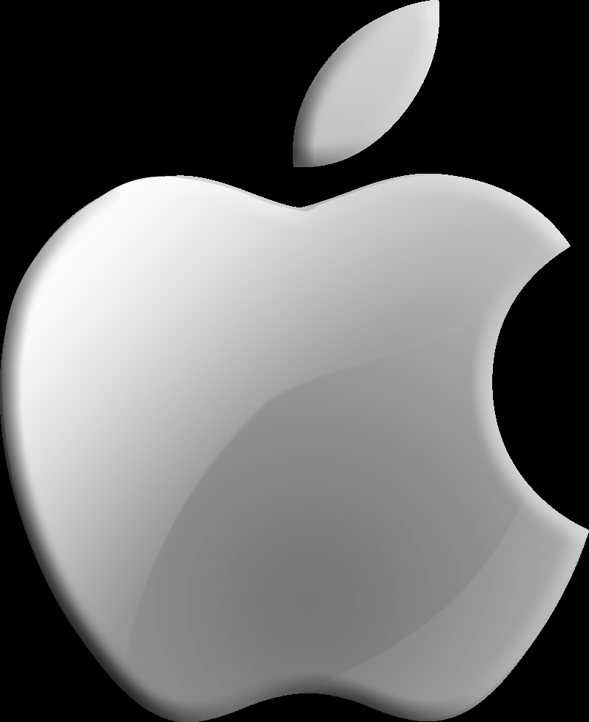
OS X (Apple)
Mac OS is the only commercial operating system that is custom-made to work with Apple’s hardware. This gives it a level of efficiency, power, and stability, which is most important for the workplace.
Mac OS X is still the operating system of choice for graphic artists, designers and most others who work with visual and audio media. It also synchronizes user information well across multiple Apple devices
Apple computers simply cost much more than your average PC. This is offset somewhat by those computers’ durability
Virtually virus free

Slide 18
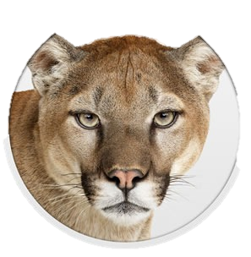
Recent Versions of OS X (since 2001)
Jaguar
Panther
Tiger
Leopard
Snow Leopard
Lion
Mountain Lion
Maverick
Yosemite

Slide 19
Apple Operating System (iPhone, iPad, iPad mini, Apple TV, iPod)
iOS (from OS X)
900,000 Apps available
300,000 Apps for iPad
Collectively downloaded >50Billion times
Interface uses multi-touch gestures
iOS 4 – iOS 7

Slide 20
Linux
Free
Easy to update and install
Easy to update many computers over a single network in a matter of minutes
Highly customizable
Users are often scared at first to use it

Slide 21
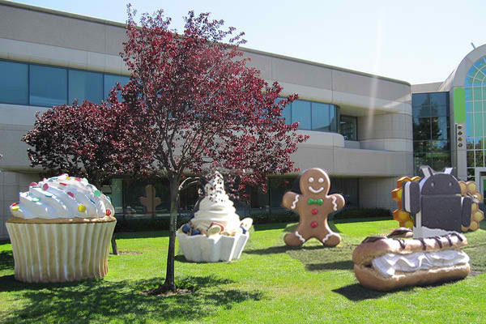
Android Operating System
Linux based operating system
Google financed and later bought
Open source code which allows software to be freely modified and distributed
700,000 Apps with 48 Billon Downloaded
Cupcake, Donut, Éclair, Froyo, Gingerbread, Honeycomb, Ice Cream Sandwich, Jelly Bean, Kit Kat

Slide 22
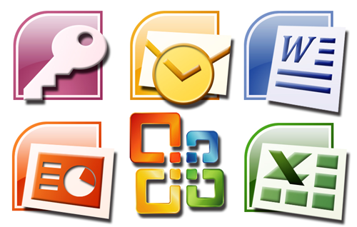
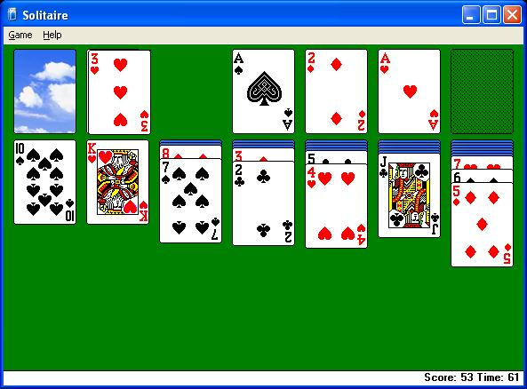
Application Software
Software that helps users perform tasks

Slide 23
5 steps to Information Processing
Input
Processing
Distribution
Output
Storage

Slide 24
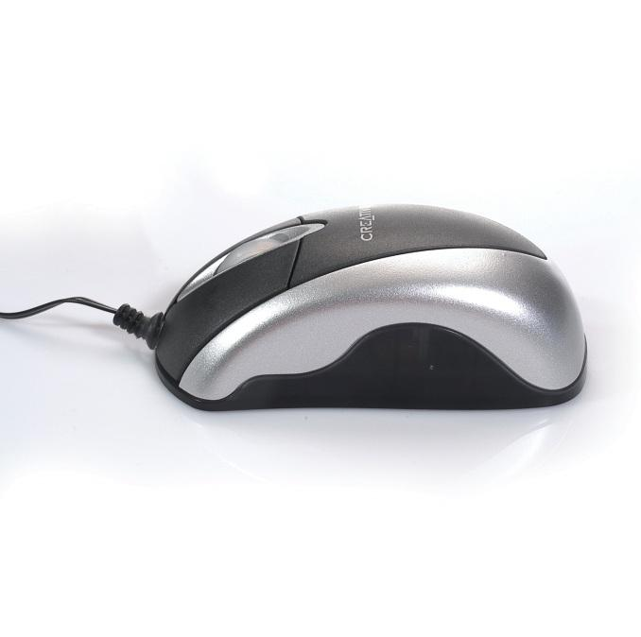
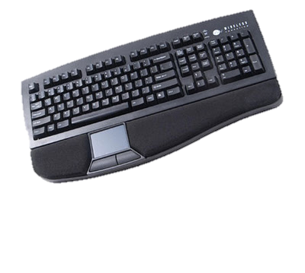
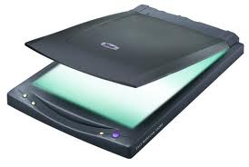
INPUT
To give data to the computer

Slide 25
PROCESSING
Processing:
To change or use data
Your computer doesn’t just read information as letters and numbers, it has a different language.
Where does all of the computer’s processing go through?

Slide 26
Binary Code
Base 2 number system
Made up of 1’s and 0’s
The “language” of the computer

Slide 27
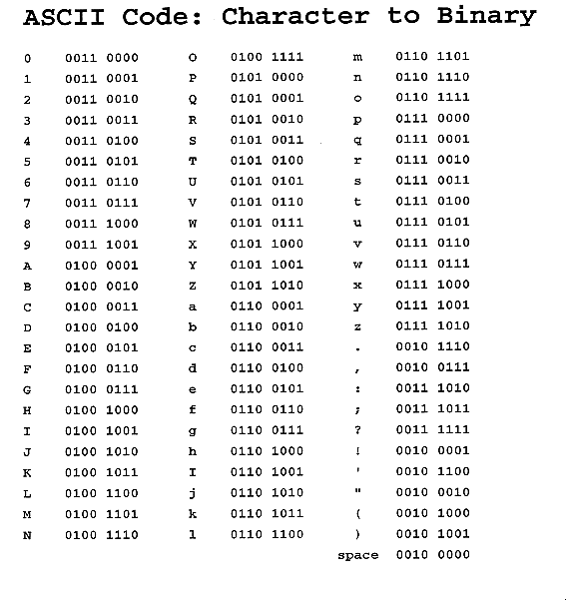

Slide 28
DISTRIBUTION
Distribution:
To send data to the location that needs it.
Where might a computer send data?

Slide 29
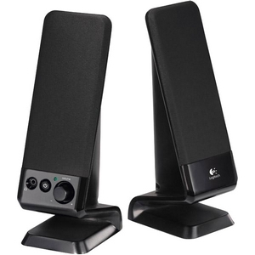
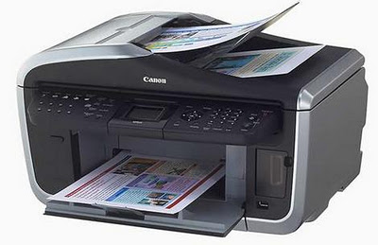
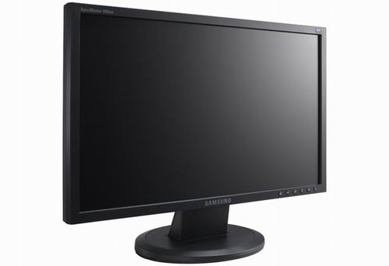
OUTPUT
To receive information from the computer.

Slide 30
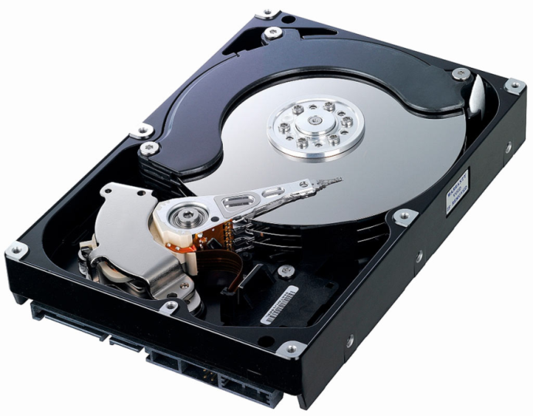
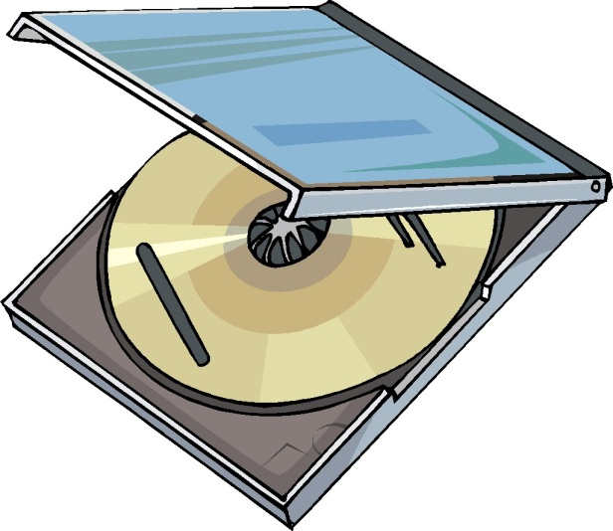
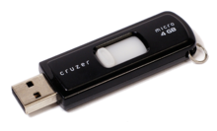
STORAGE
To save data for a later use.

Slide 31
Information Processing Recap
Input: To give
Processing: To change or use
Distribution: To send
Output: To receive
Storage: To save

Slide 32
Computer
A machine that follows a set of instructions to change and store data

